Slide 1
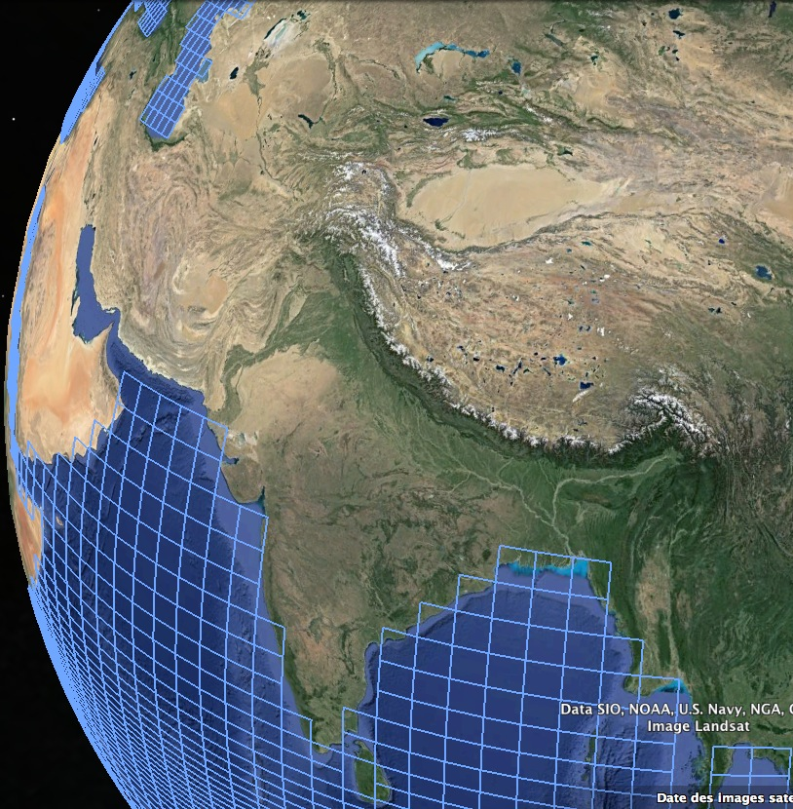

Does the quality of the high-resolution topography prescribed in LMDz alter the simulated climate ?
A sensitivity study with LMDZOR
Pierre Sepulchre – Journées LMDz – 11 June 2018
Notes:
Cette photo de la Nasa (MODIS) montre la partie sud des Andes. Je l’ai choisi car elle témoigne de plusieurs effets théoriques que peut avoir la topographie sur le climat.

Slide 2
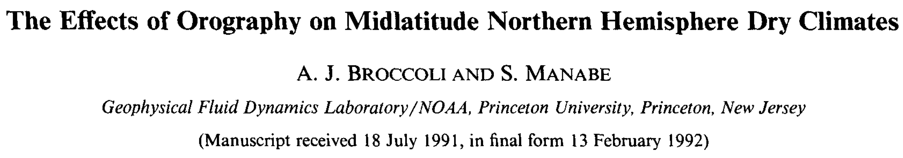
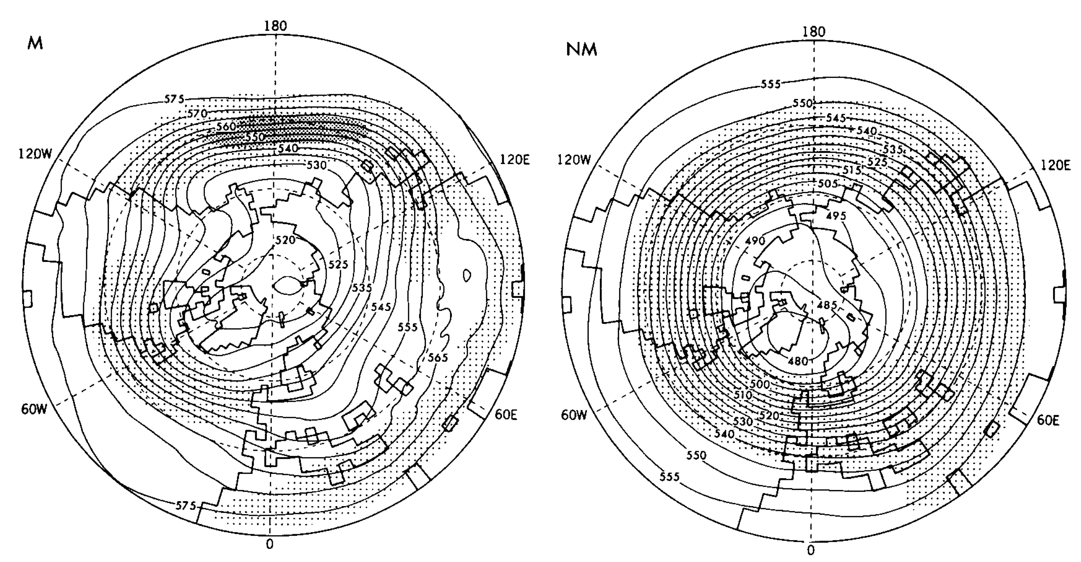
Notes:
Broccoli & Manabe: Impact des montagnes sur les ondes stationnaires + aridité

Slide 3
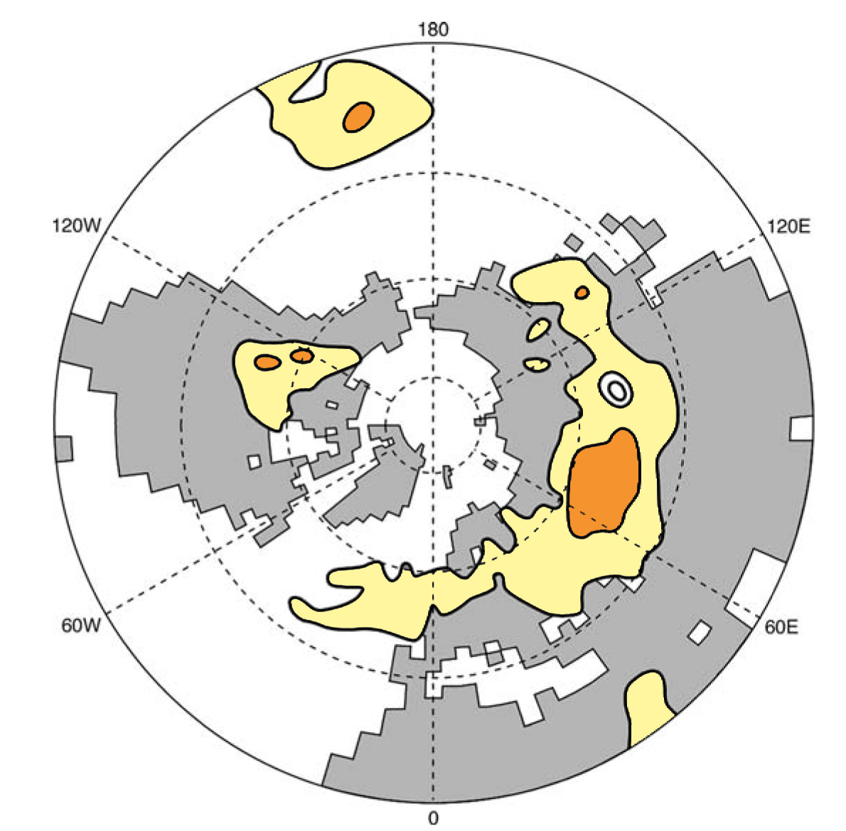
Notes:
Broccoli & Manabe: Impact des montagnes sur les ondes stationnaires + aridité

Slide 4
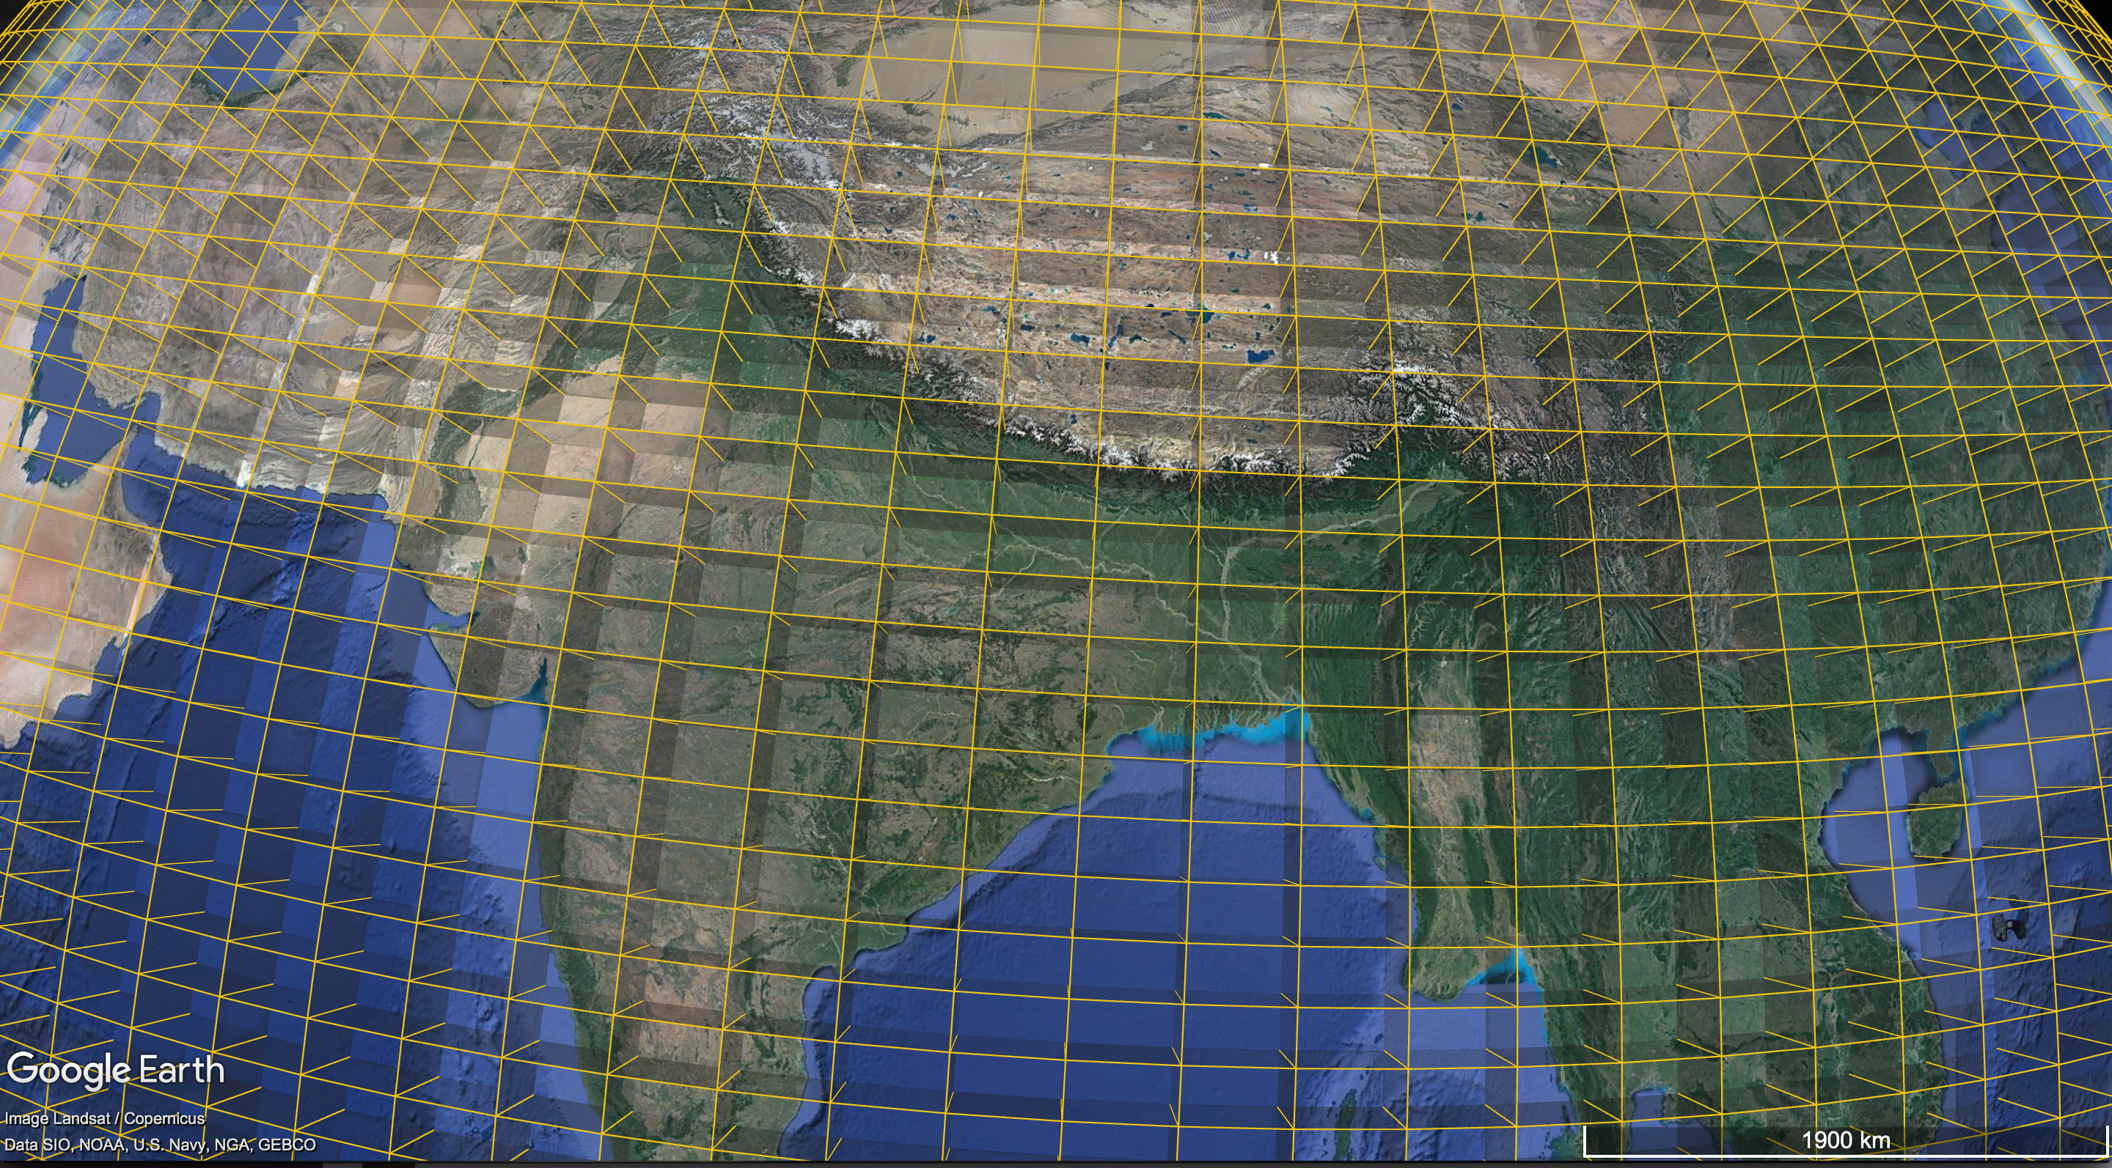

Slide 5
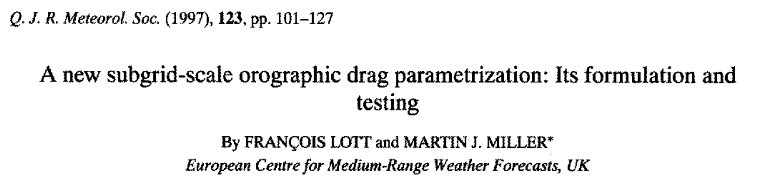
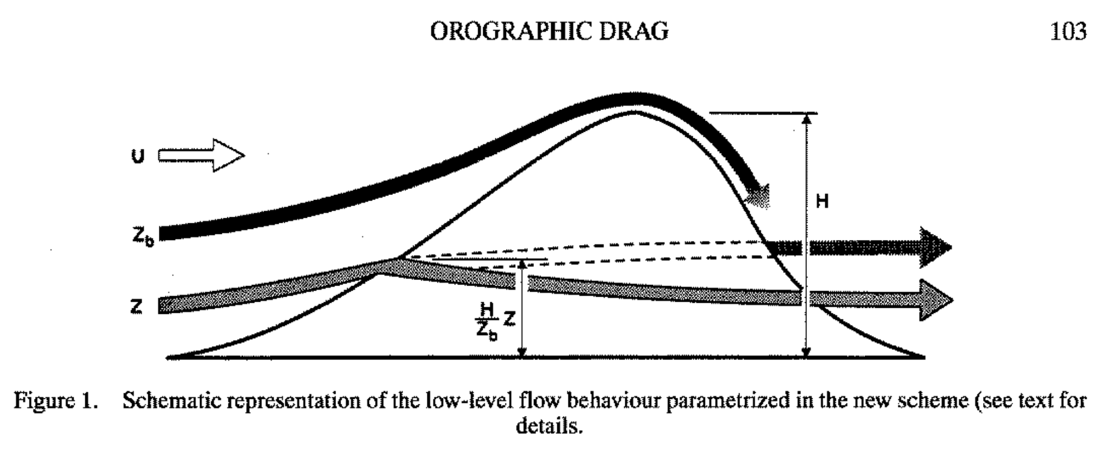
Mean slope
Highest elevation (peaks)
Lowest altitude (valleys)
Standard deviation

Slide 6
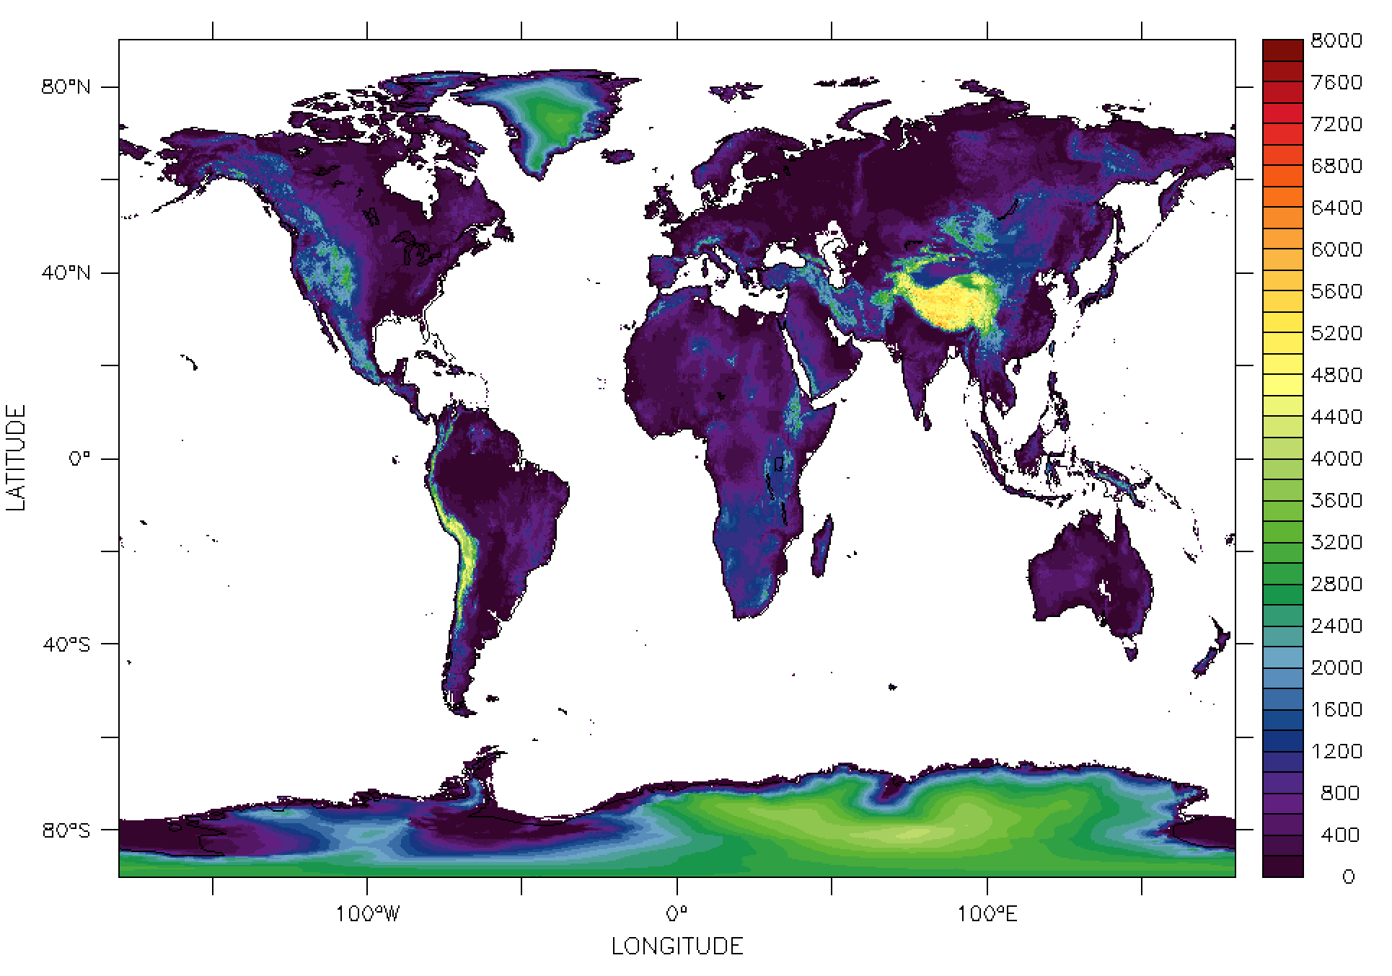
Relief.nc
10’ elevation dataset

Slide 7
Relief.nc
[…] originally created by the United States Navy, Fleet Numeric Oceanography Center (FNOC) in the 1960s and 1970s
[…] entailed manually extracting elevations from small-scale navigational charts and subsequently converting the values into a digital format […] Elevation values were visually estimated from topographic contours on the charts for 10 x 10-minute coordinate areas. Values were hand written onto forms and later scanned by an optical character reader for computer storage of the data.
[…] In the 1980s, the National Center for Atmospheric Research conducted tests on the modal elevation values to locate additional errors.
[…] In 1984, NGDC analyzed the data for any remaining significant errors. A few erroneous values were identified in the modal and minimum data. […] Suspect values were compared with estimated values, and where the estimates seemed better than the original values, they were inserted into the data set.
Origin ??
Joseph, 1980, Navy 10' global elevation values -- National Center for Atmospheric Research notes on the Fleet Numerical Weather Center terrain data set

Slide 8
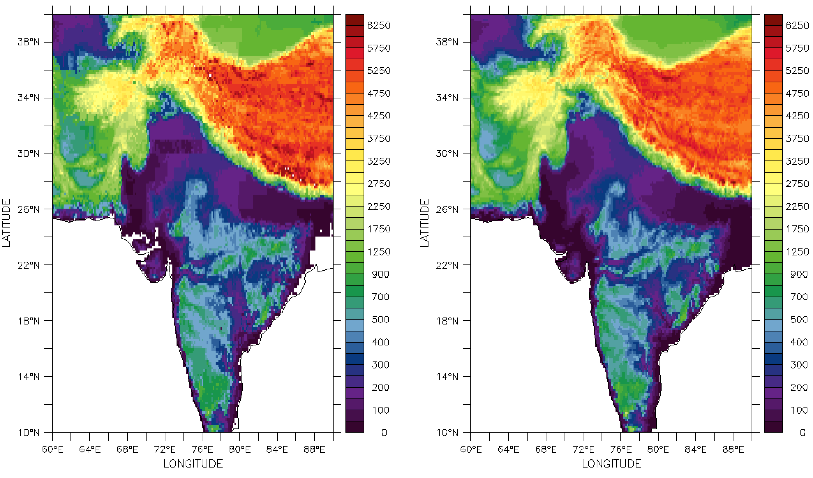
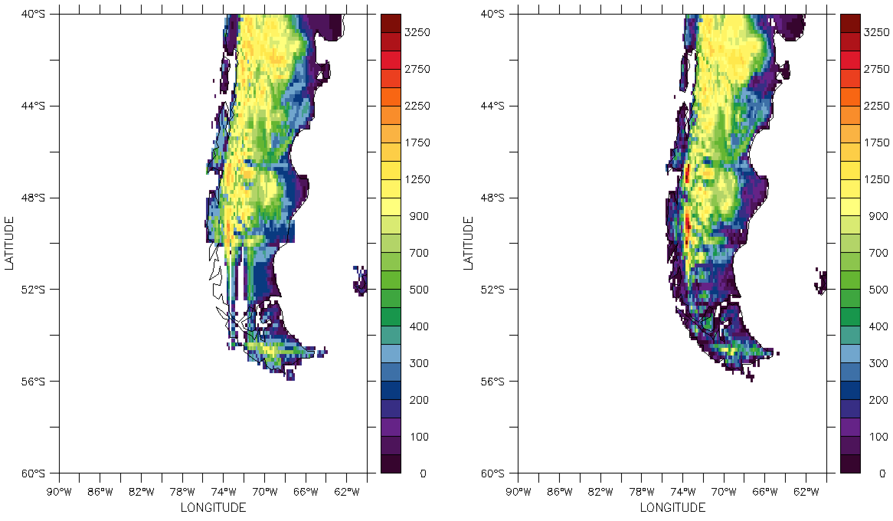

Slide 9
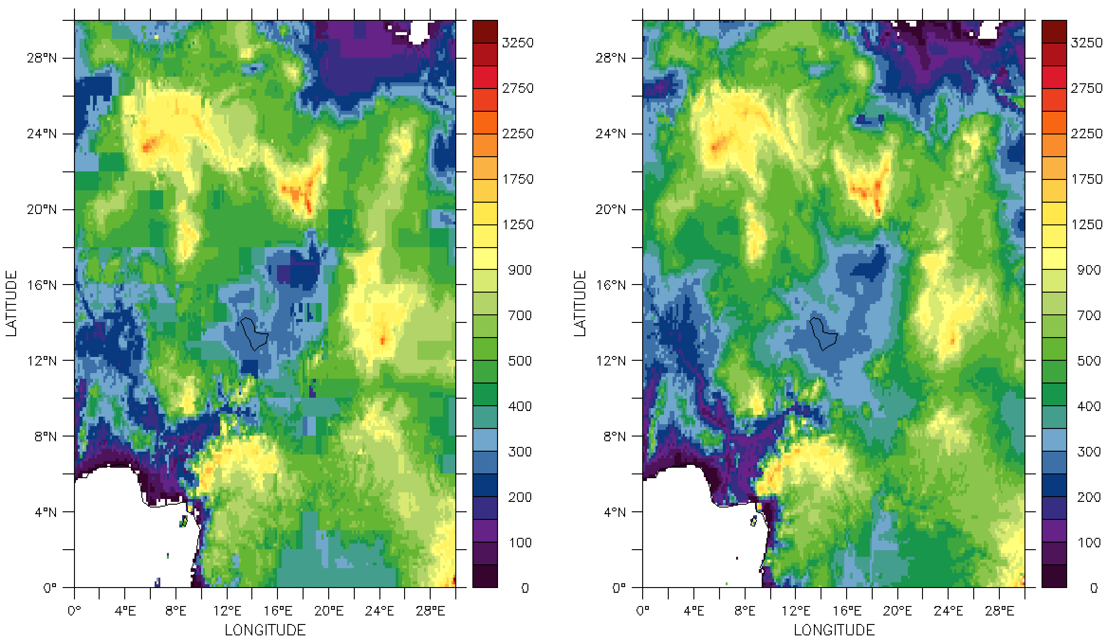
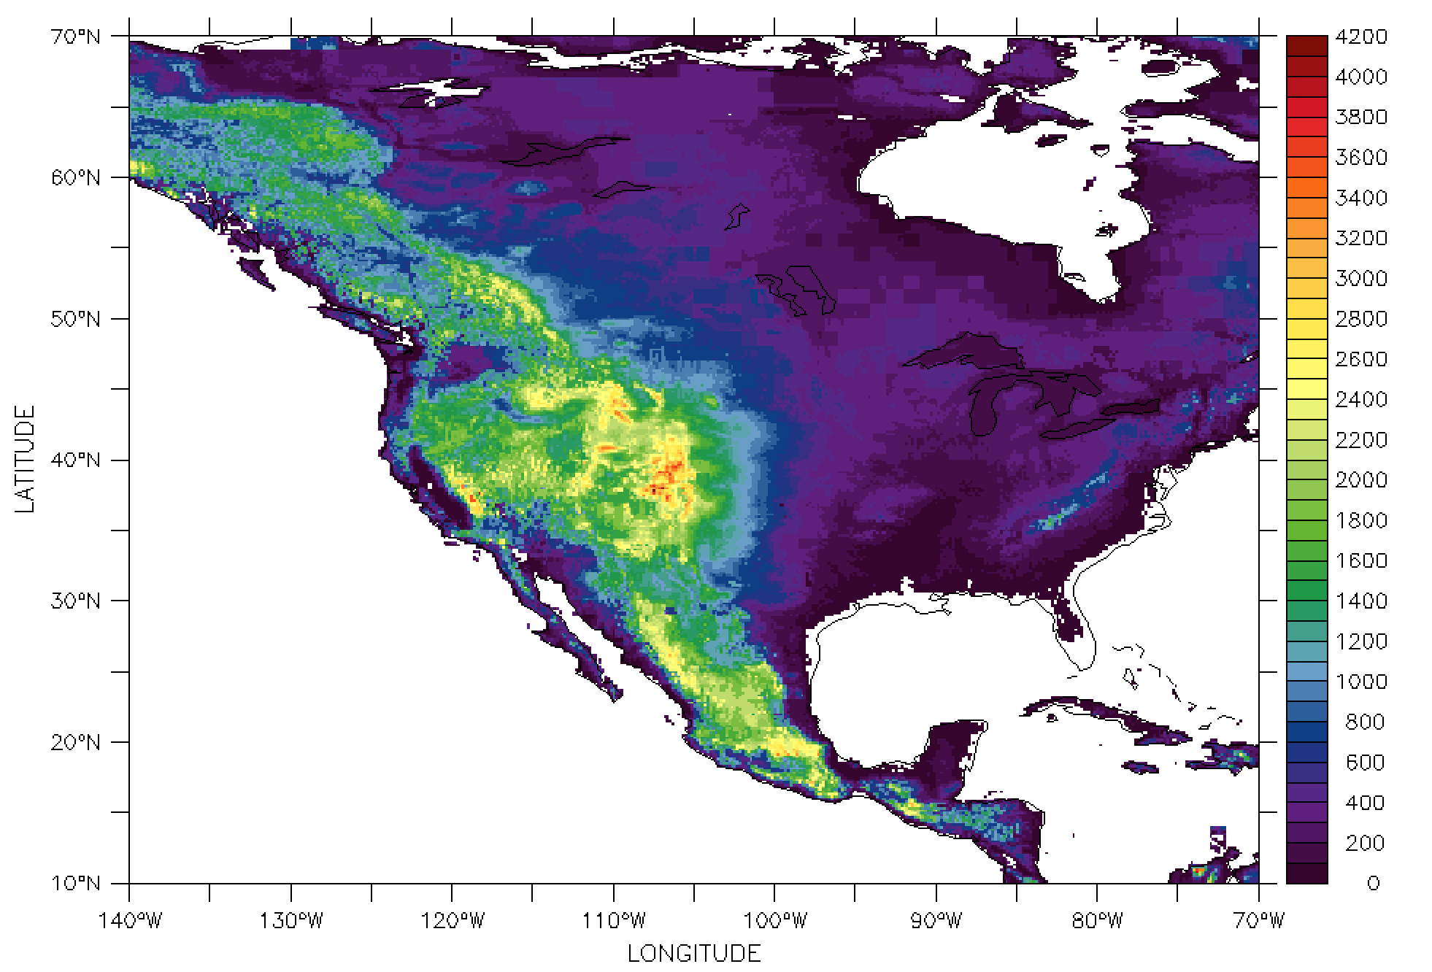

Slide 10
Relief.nc
etopo2

Slide 11
Relief.nc
etopo2

Slide 12
Relief.nc
etopo2

Slide 13
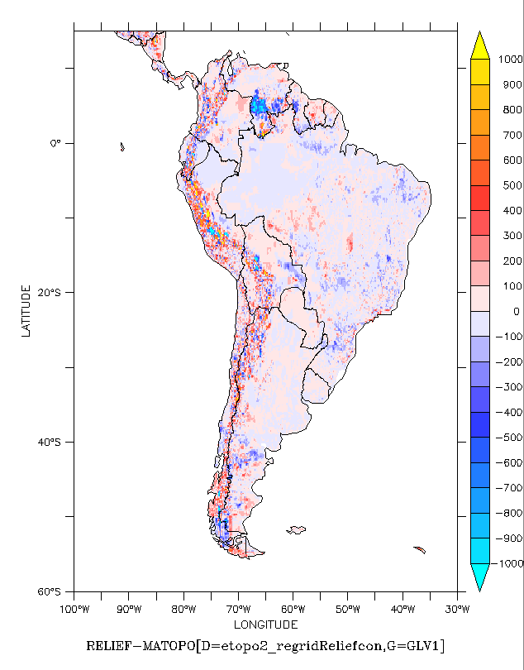
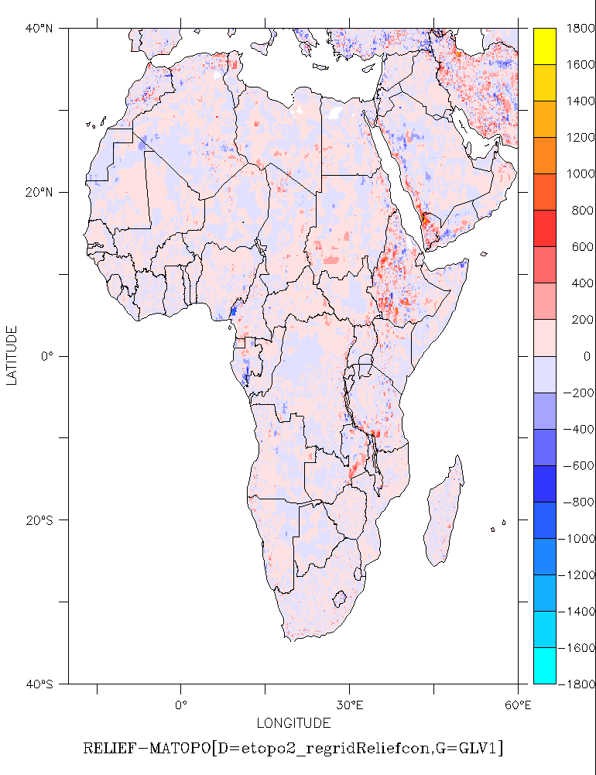

Slide 14
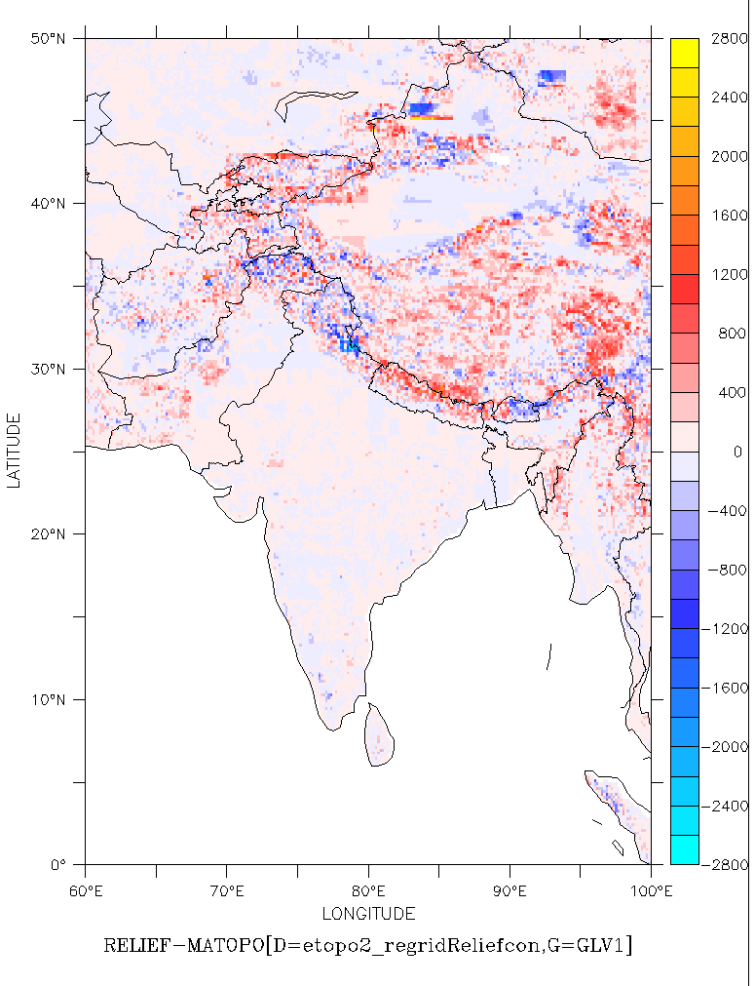

Slide 15
Relief | etopo2
Relief.nc | Etopo2 reinterpolated (bilinear using cdo)
LMDZ5 rev2875 96X95x39 old physics
ORCHIDEE rev 4441
Classic Pre-industrial run (50 years)

Slide 16
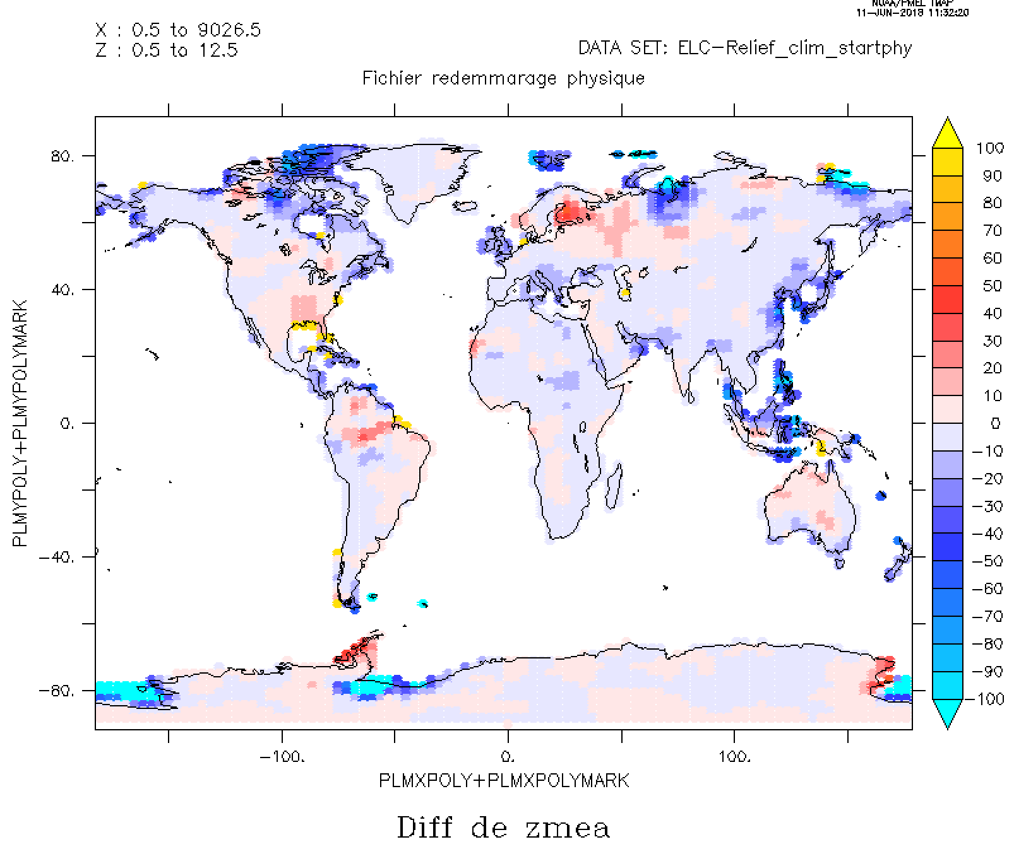
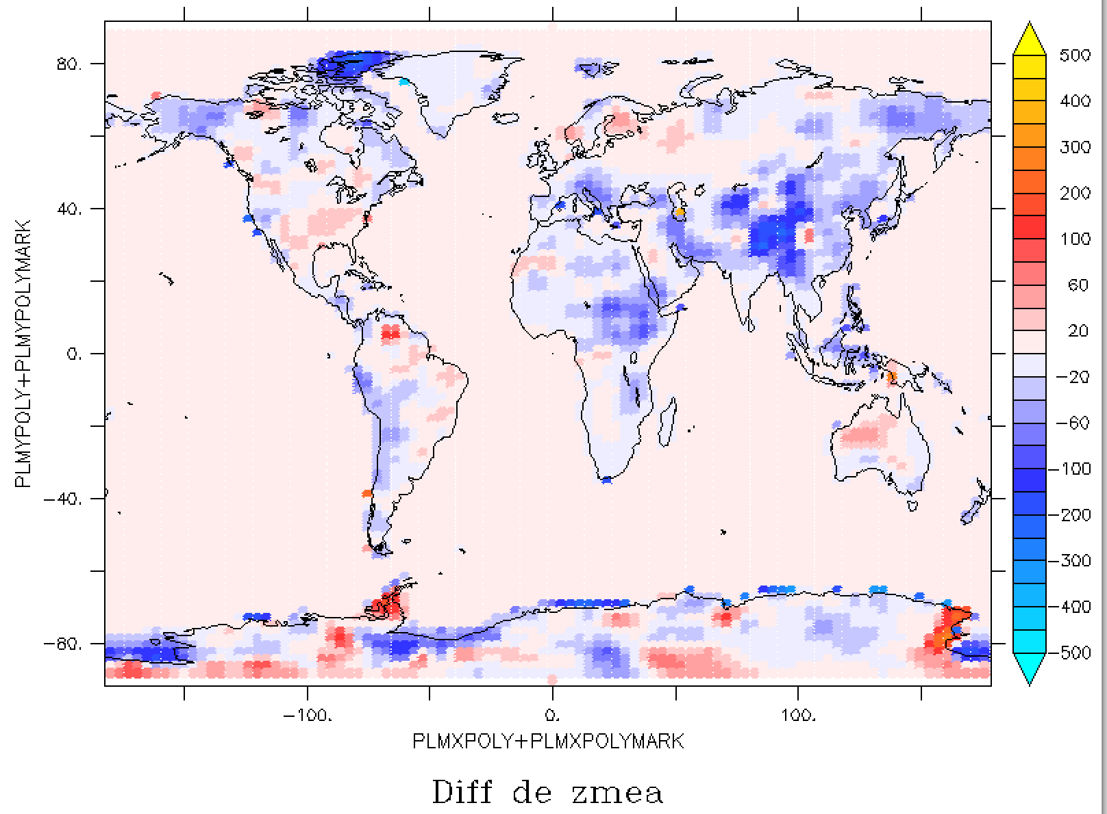
Mean elevation : etopo2-Relief
(relative)
Mean elevation : etopo2-Relief
(absolute values)

Slide 17
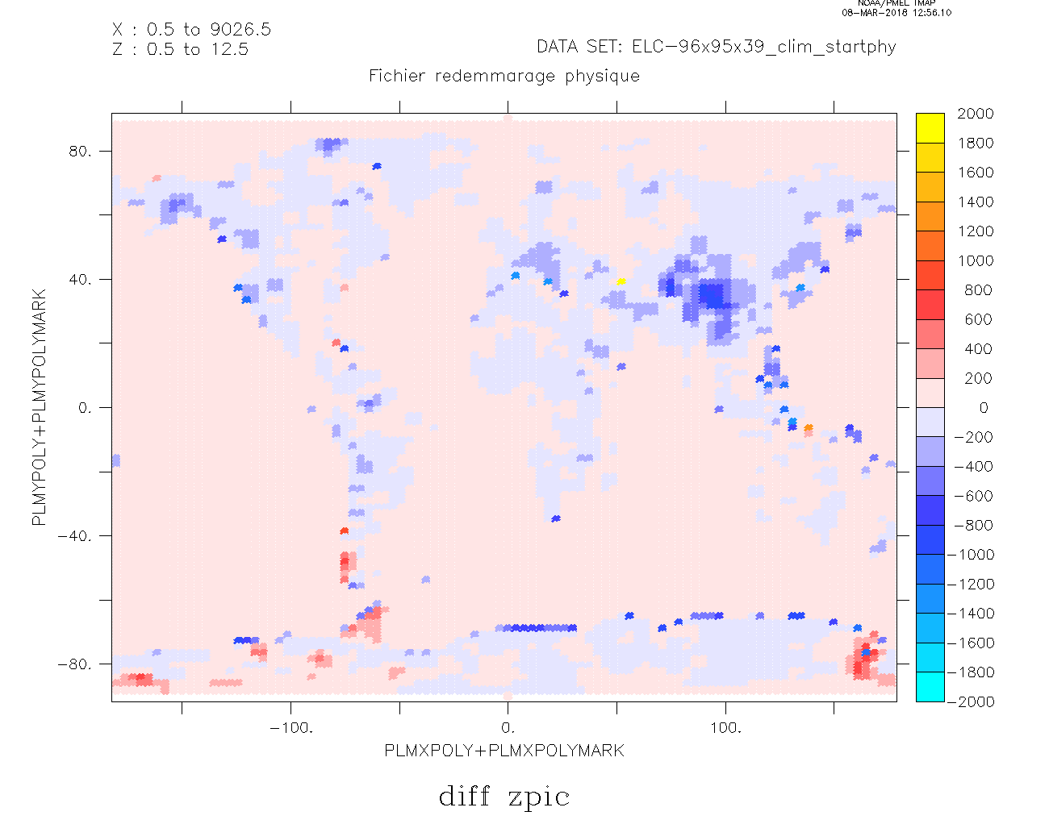
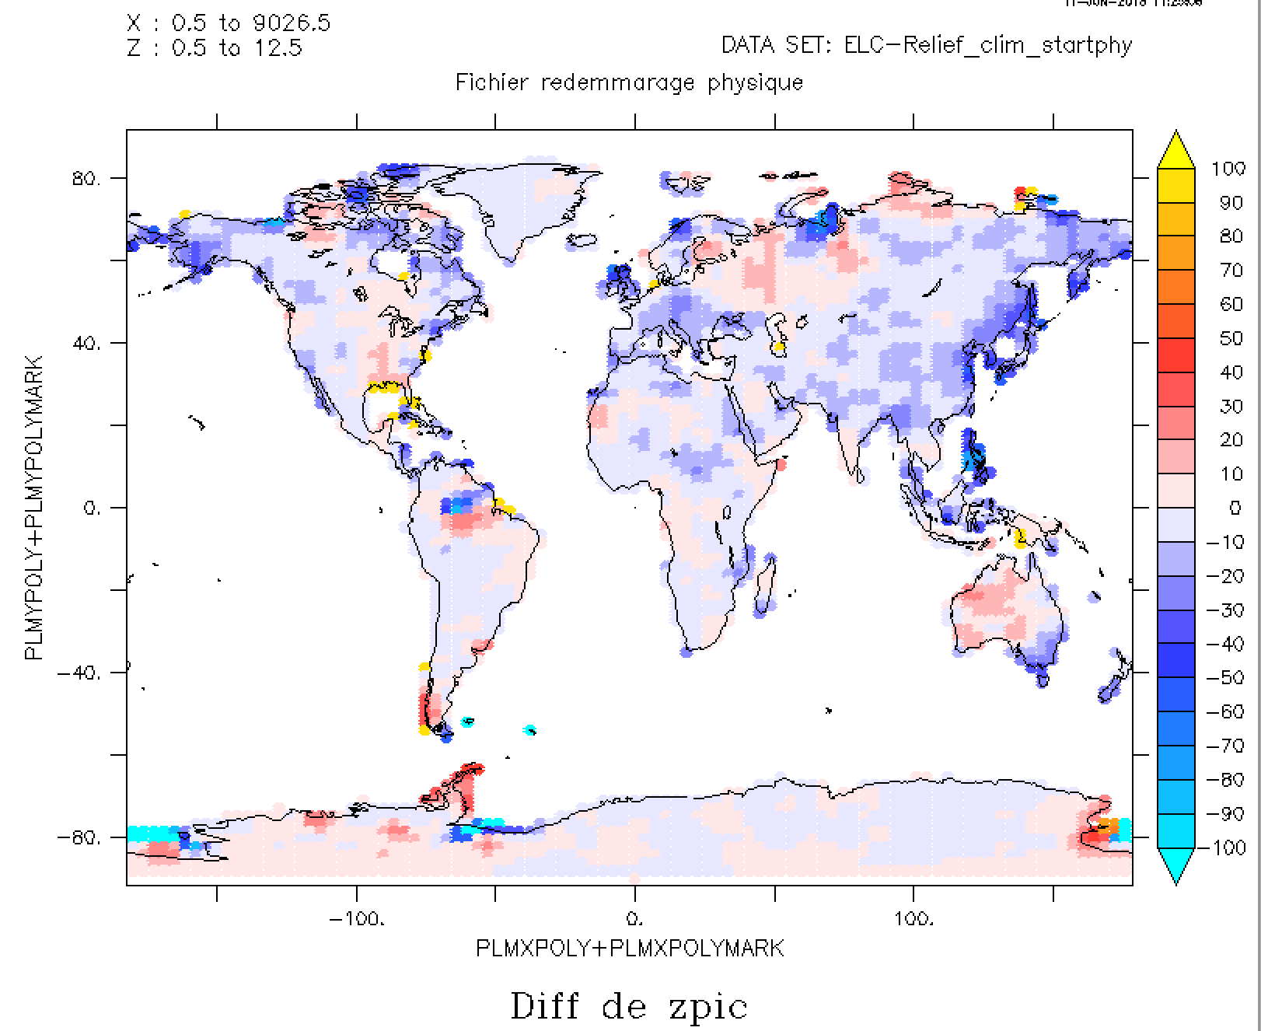

Slide 18
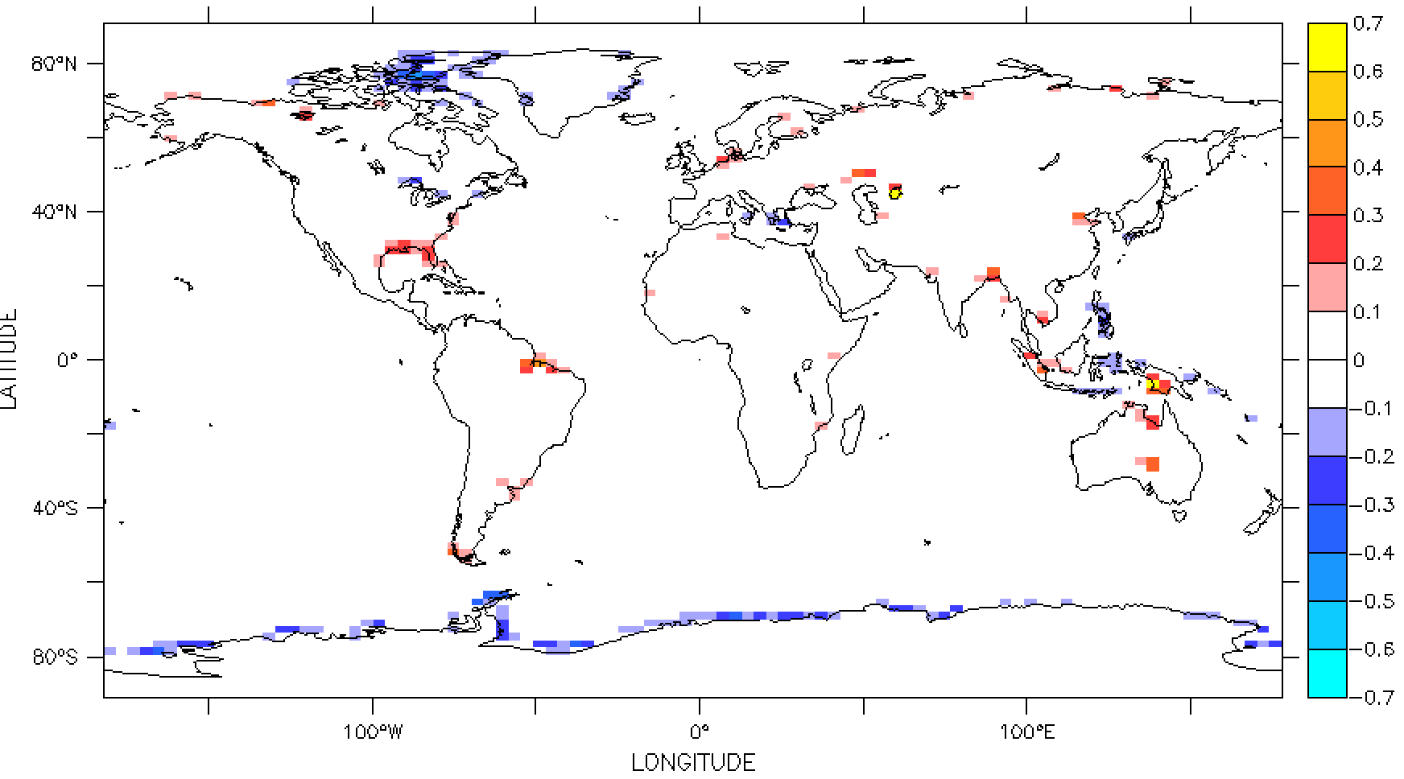
Frac ter : etopo2-Relief
(absolute values)

Slide 19
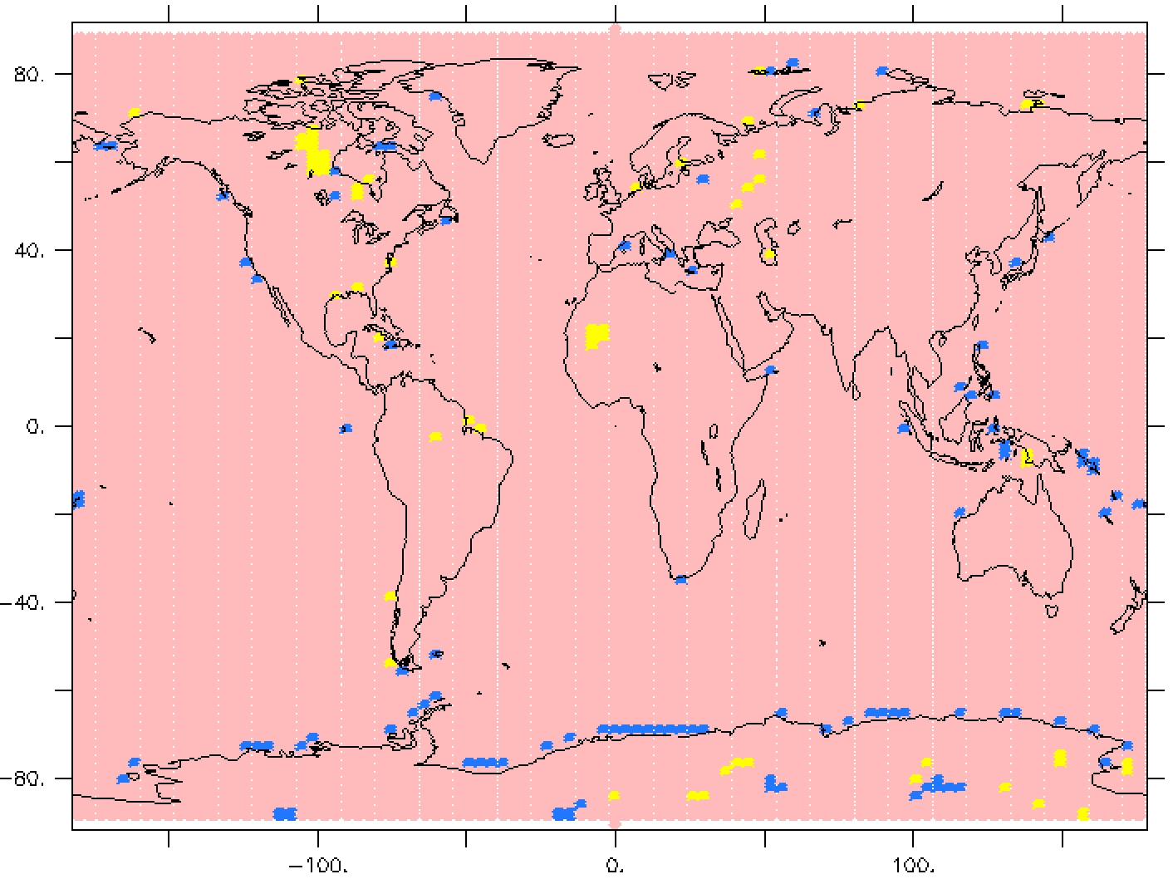
Where SSO is activated/unactivated
Notes:
if zpicmzmea GT 100 AND zstd GT 10 then 1 else 0

Slide 20
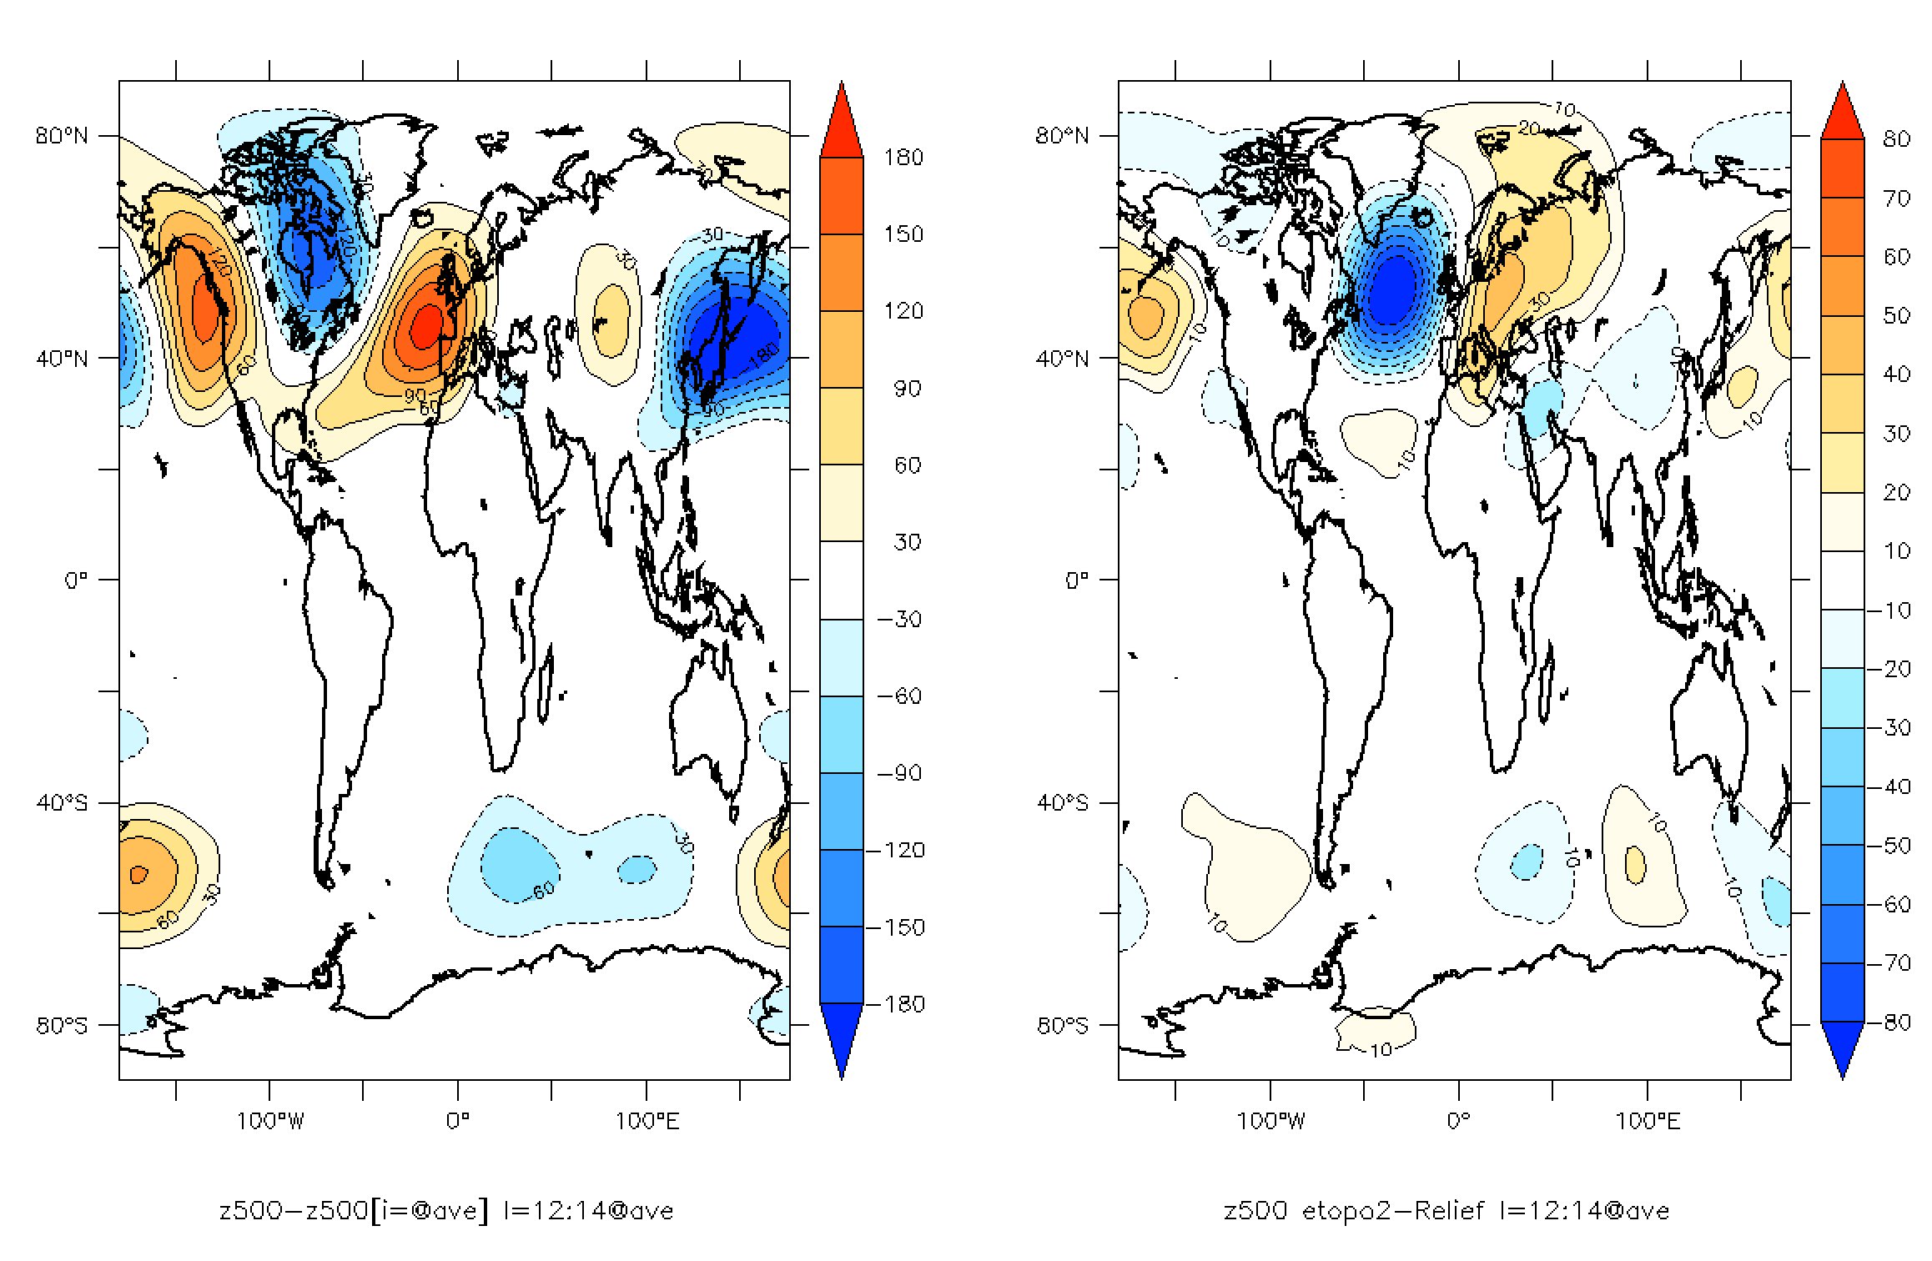
10-year averaged (year 11→20)
500hPa geop
Etopo2-relief

Slide 21
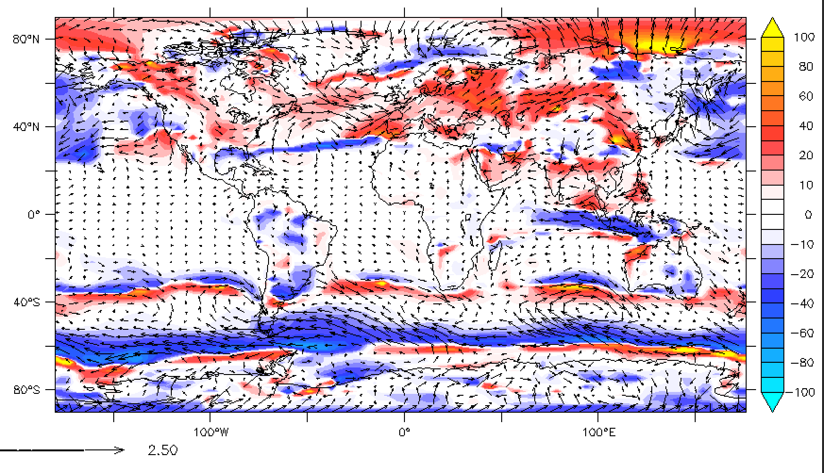
10-year averaged (year 11→20)
10m wind module etopo2-Relief (%)

Slide 22
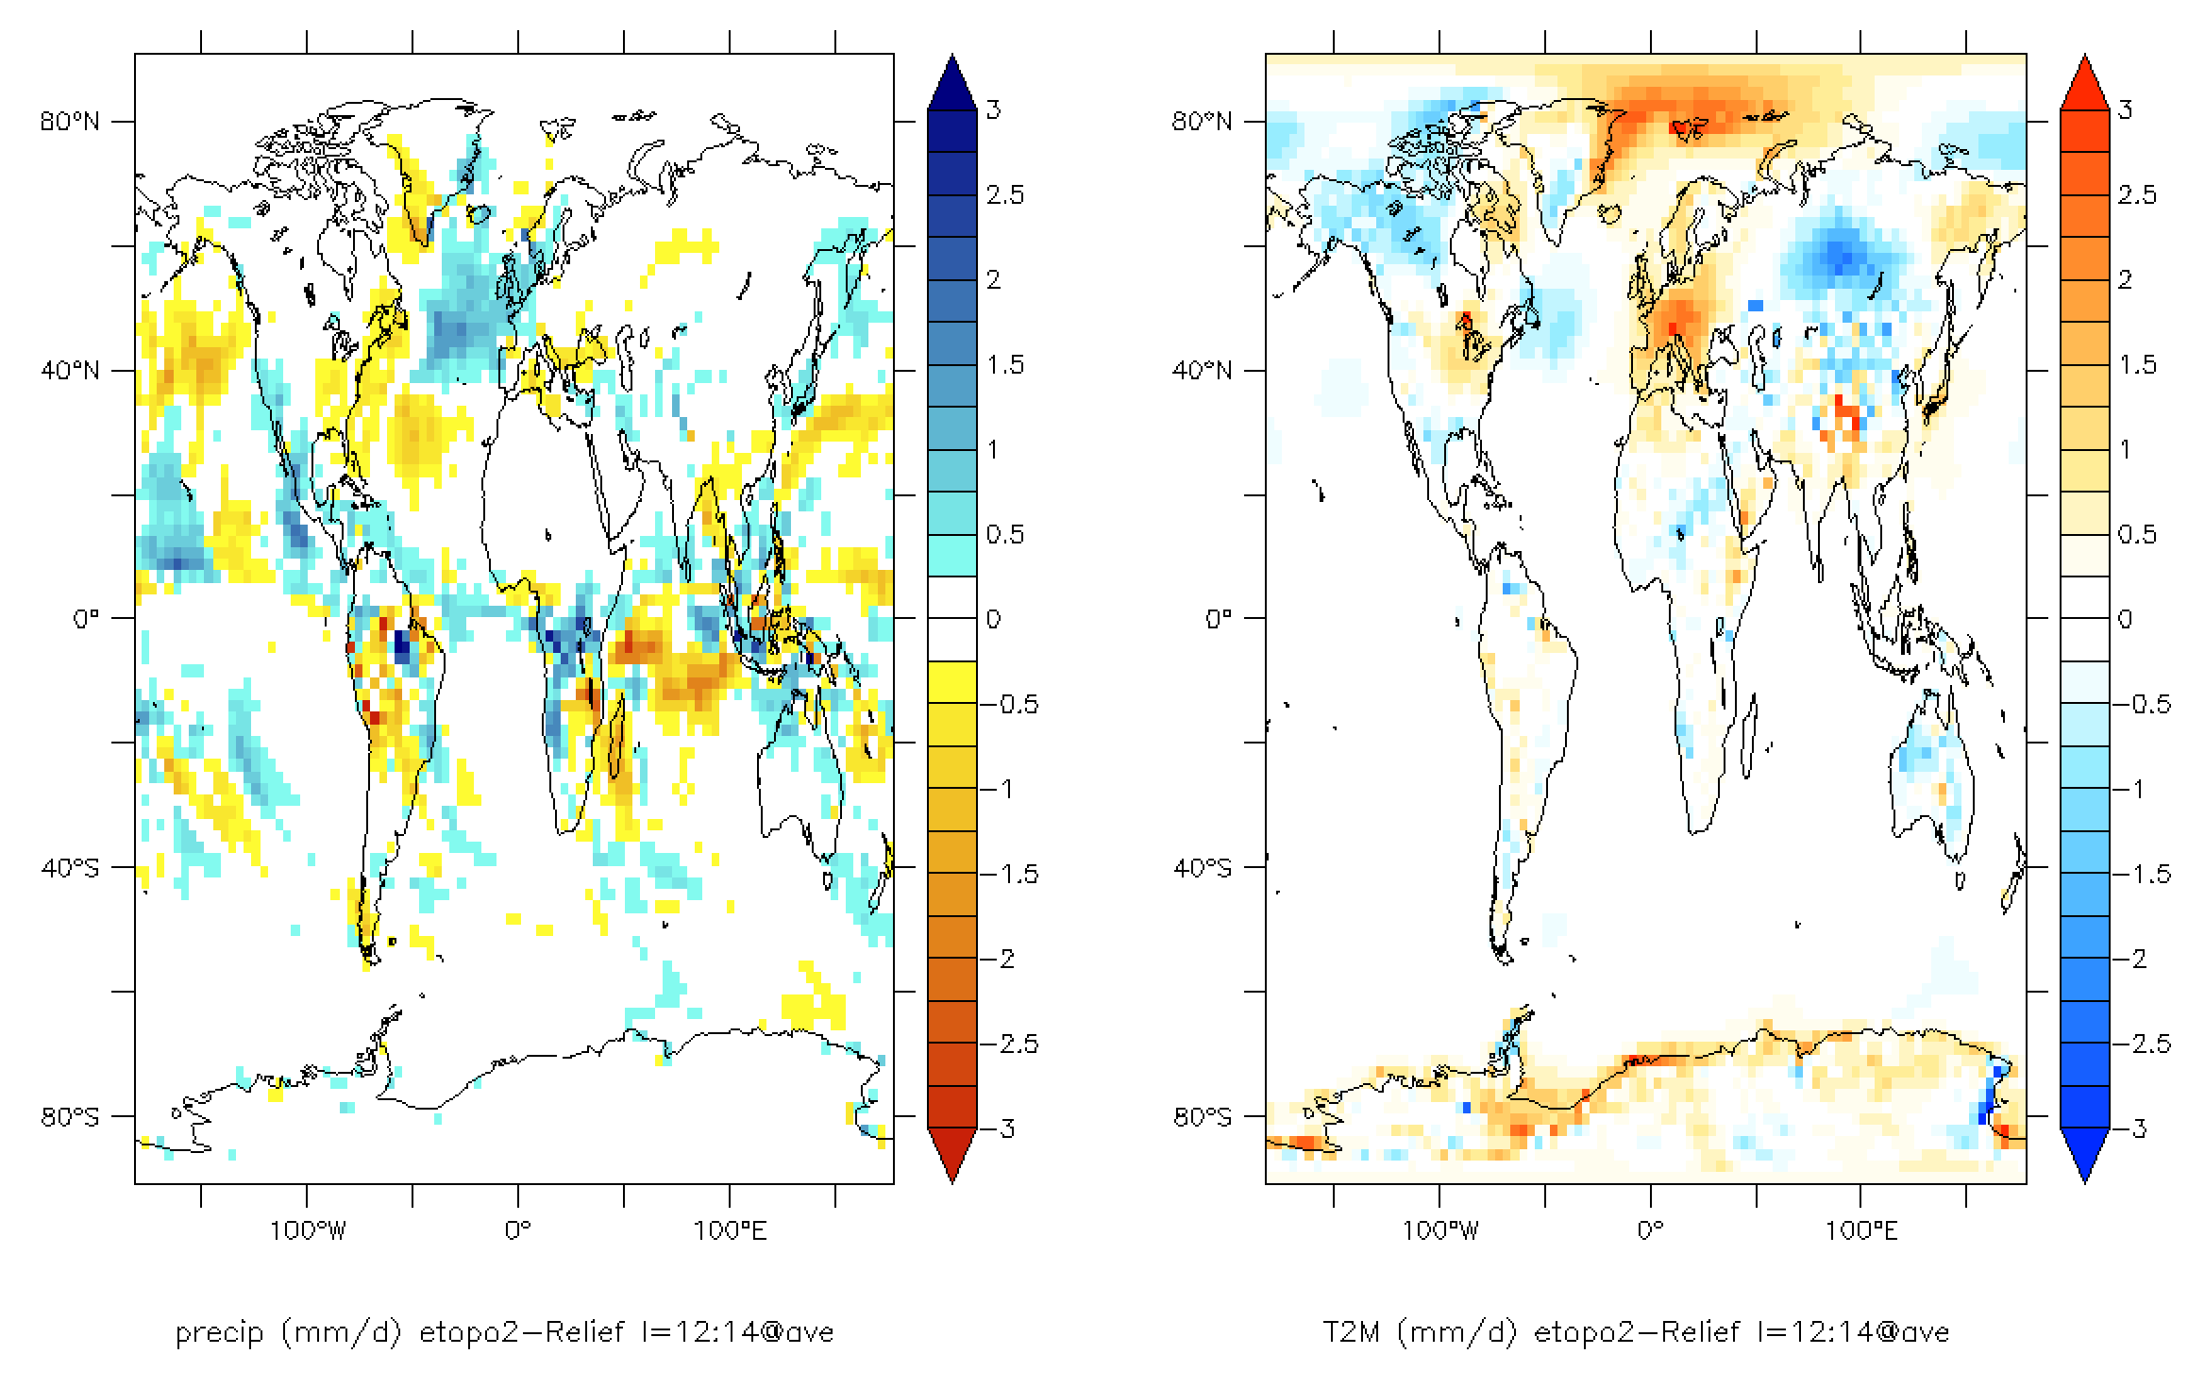
10-year averaged (year 11→20)

Slide 23
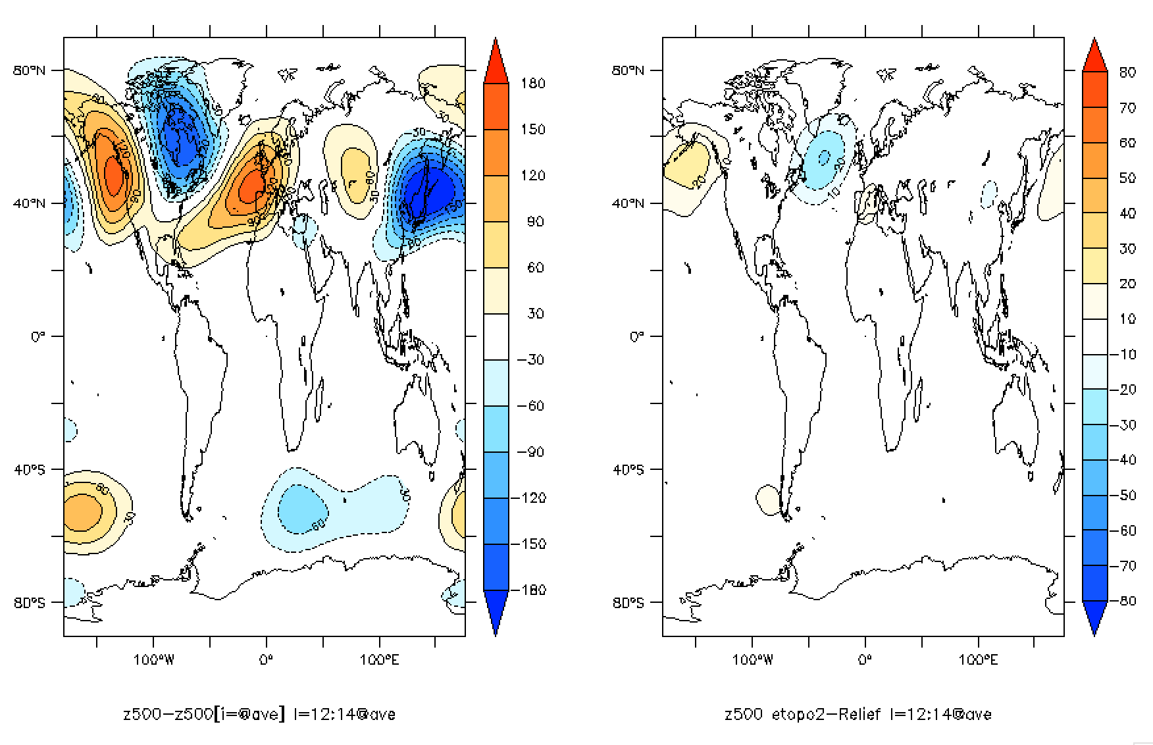
50-year averaged

Slide 24
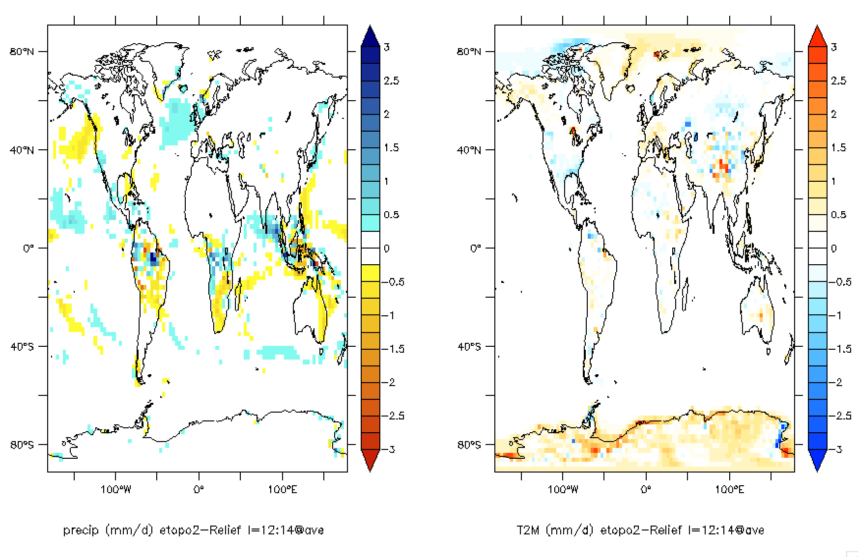
50-year averaged

Slide 25
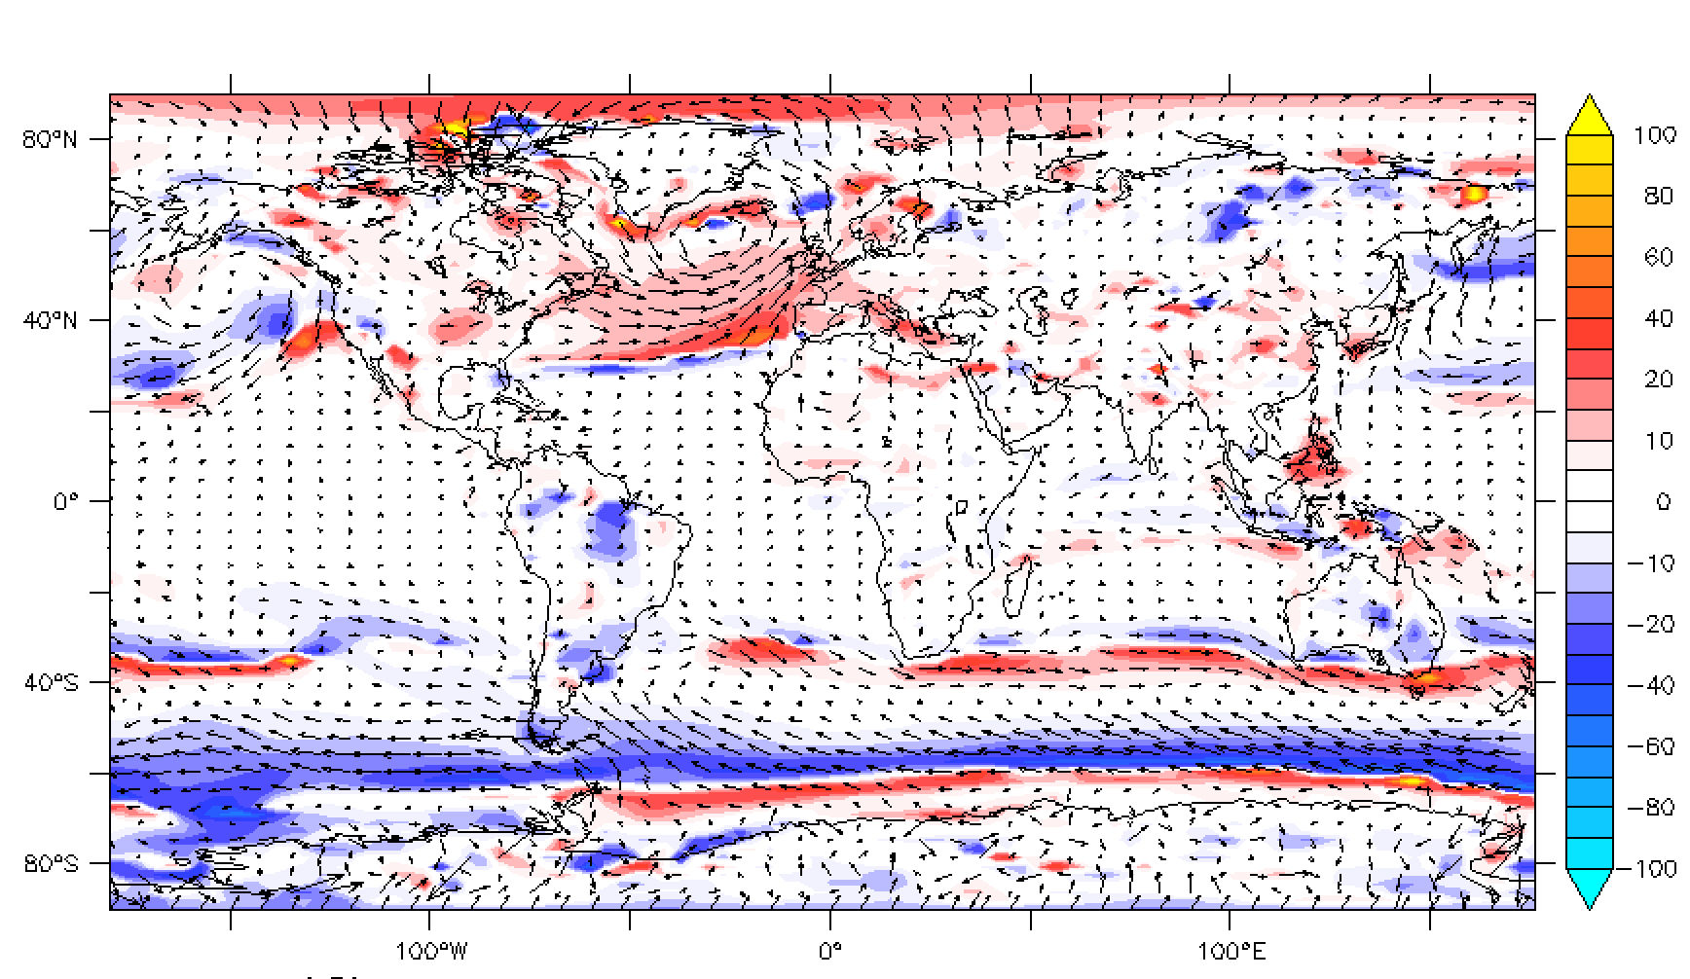
50-year averaged
10m wind module etopo2-Relief (%)

