Slide 1
Biais tropicaux et flux de surface océan-atmosphère, que peut-on en dire à partir des simulations CMIP6
P. Braconnot
PEDALONS, 14 octobre 2019
À partir de tests de sensibilité autour CMIP6 + résultats thèse Olivier Torres

Slide 2
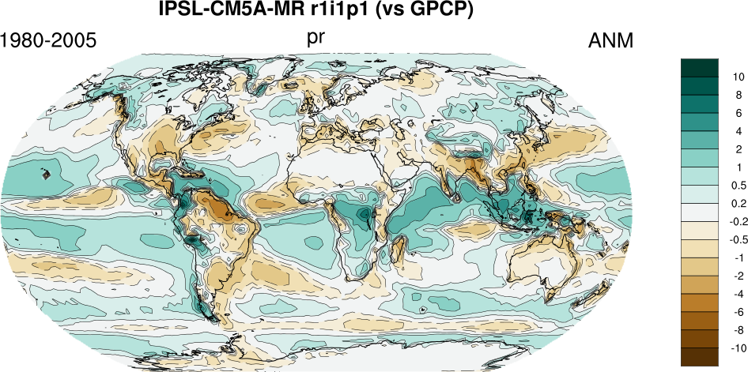
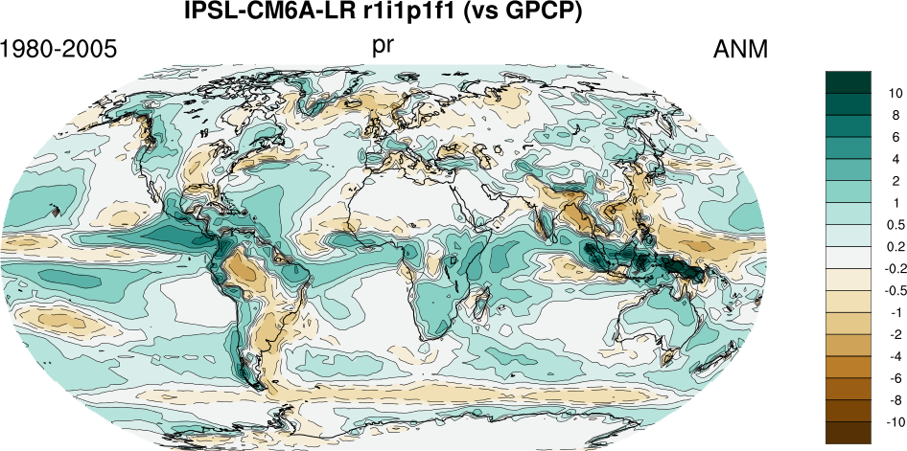
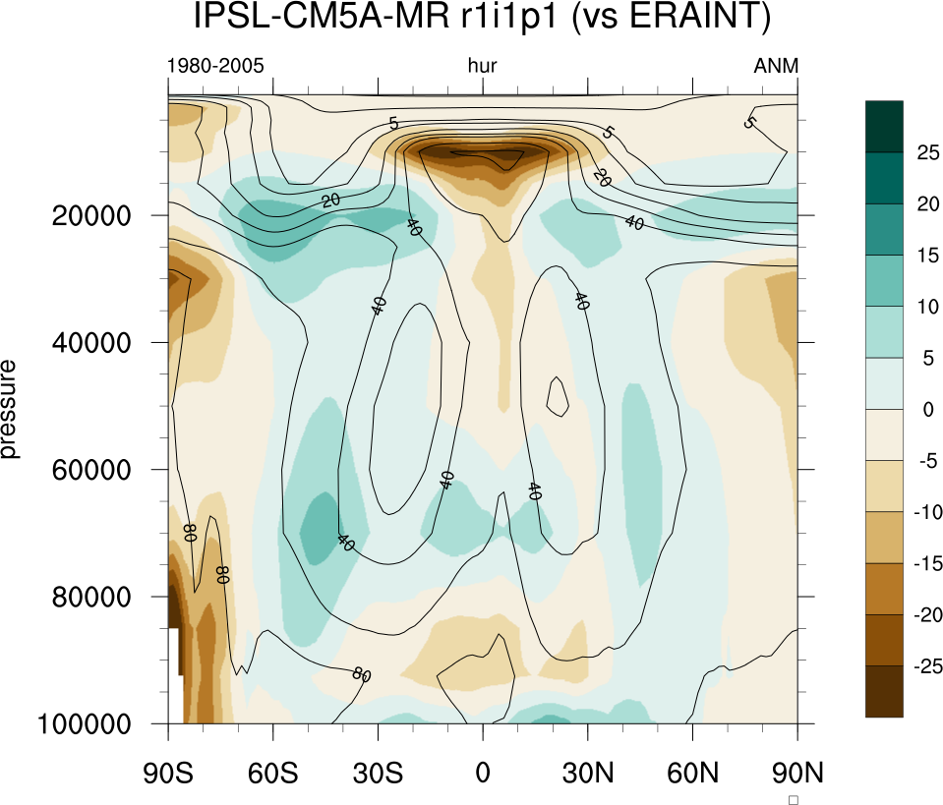
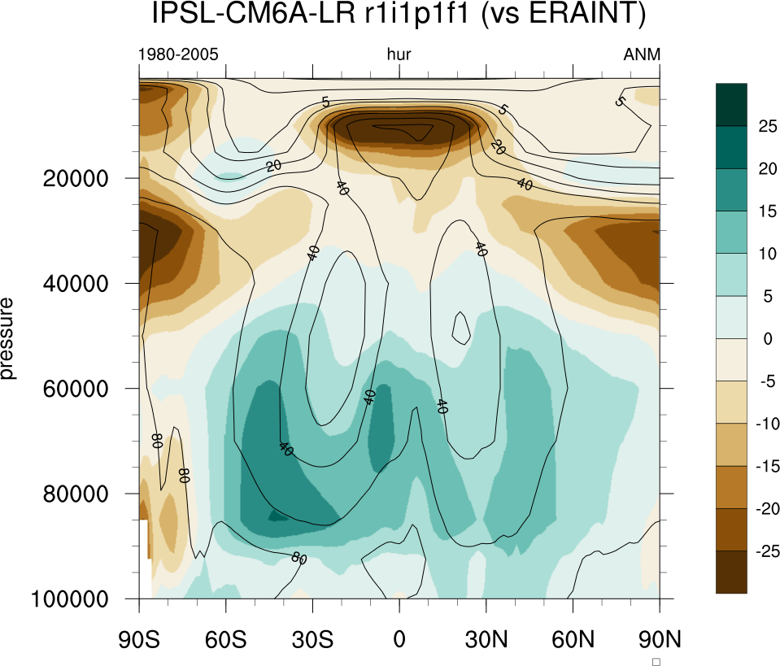
Biais région « warm pool » Pacifique

Slide 3
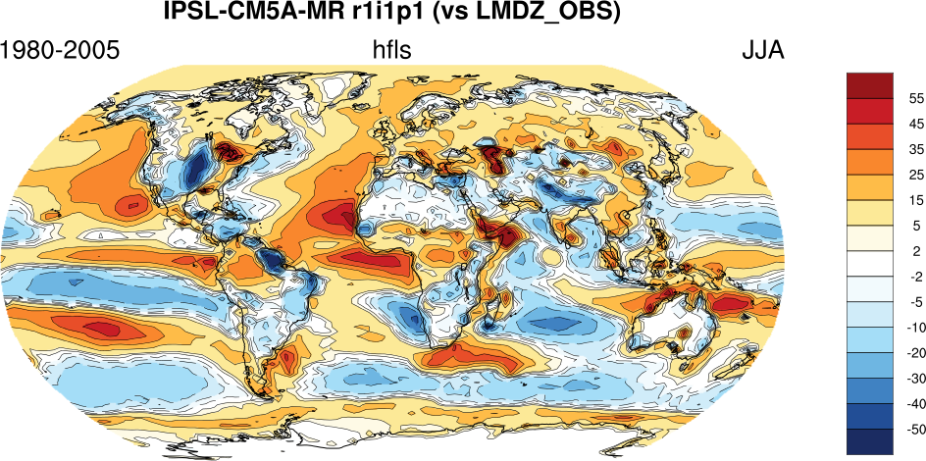
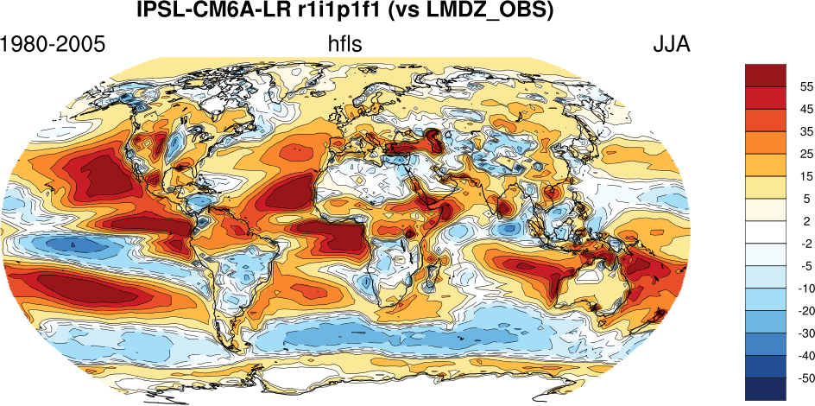
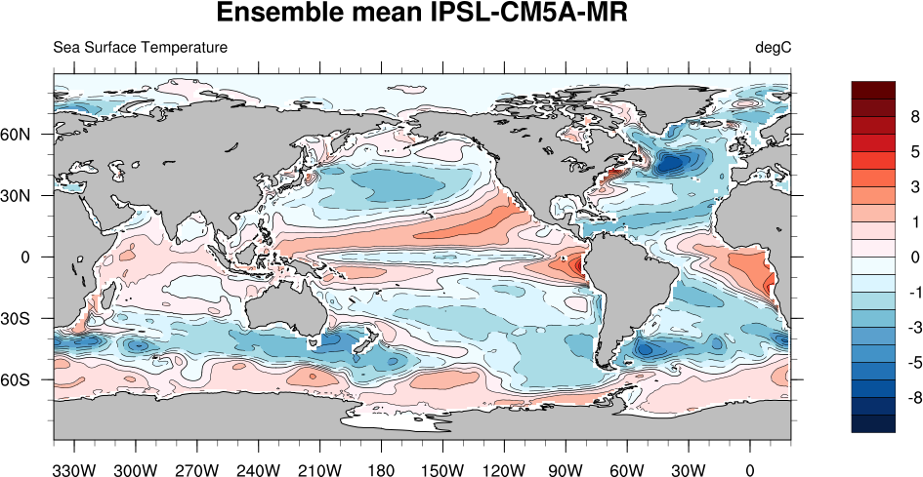
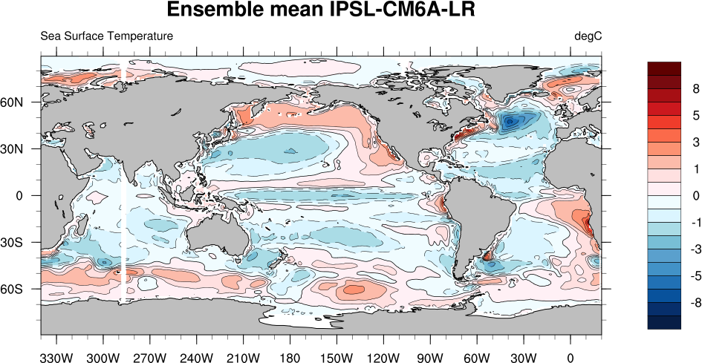
Un latent dégradé alors que SST non

Slide 4
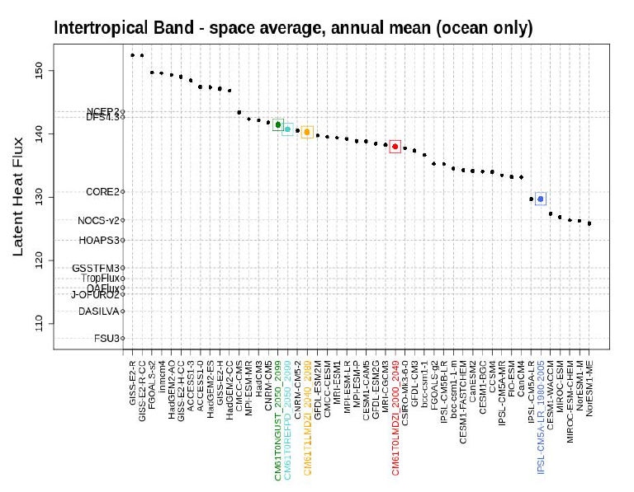
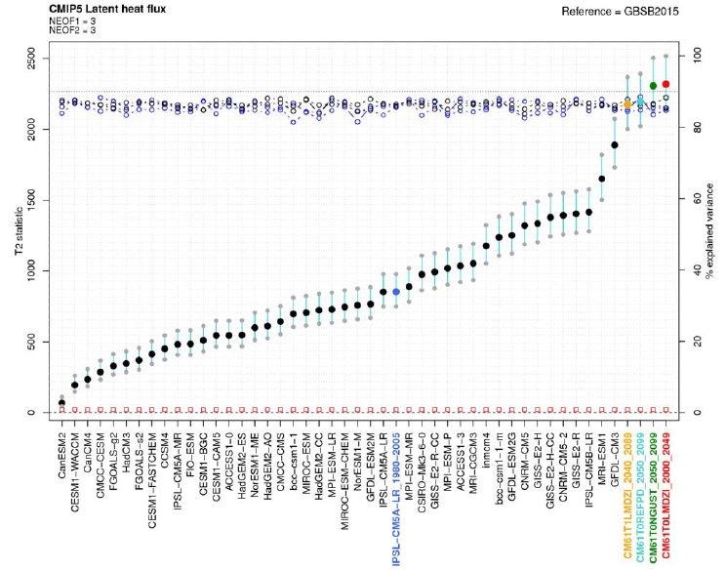
Test « objectif » Hotteling : latent surface
Average over tropical ocean
Multivariate spatiotemporal seasonal cycle
D’après Servonnat et al . 2017

Slide 5
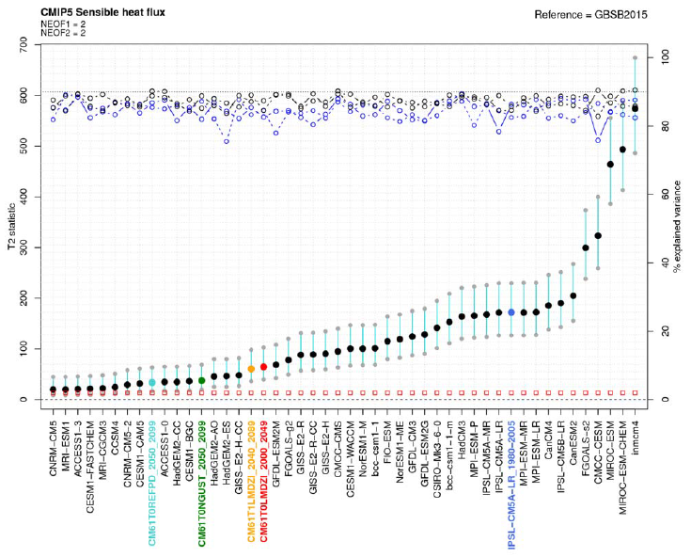
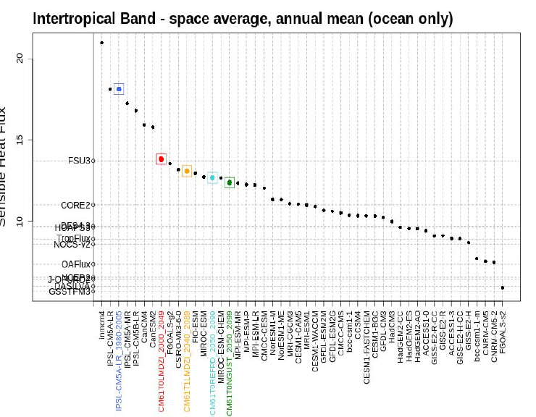
And latent ?
Suggest better representation of Tair - SST
Wind stress component ~similar or slightly degrated (mostly due to pattern).

Slide 6
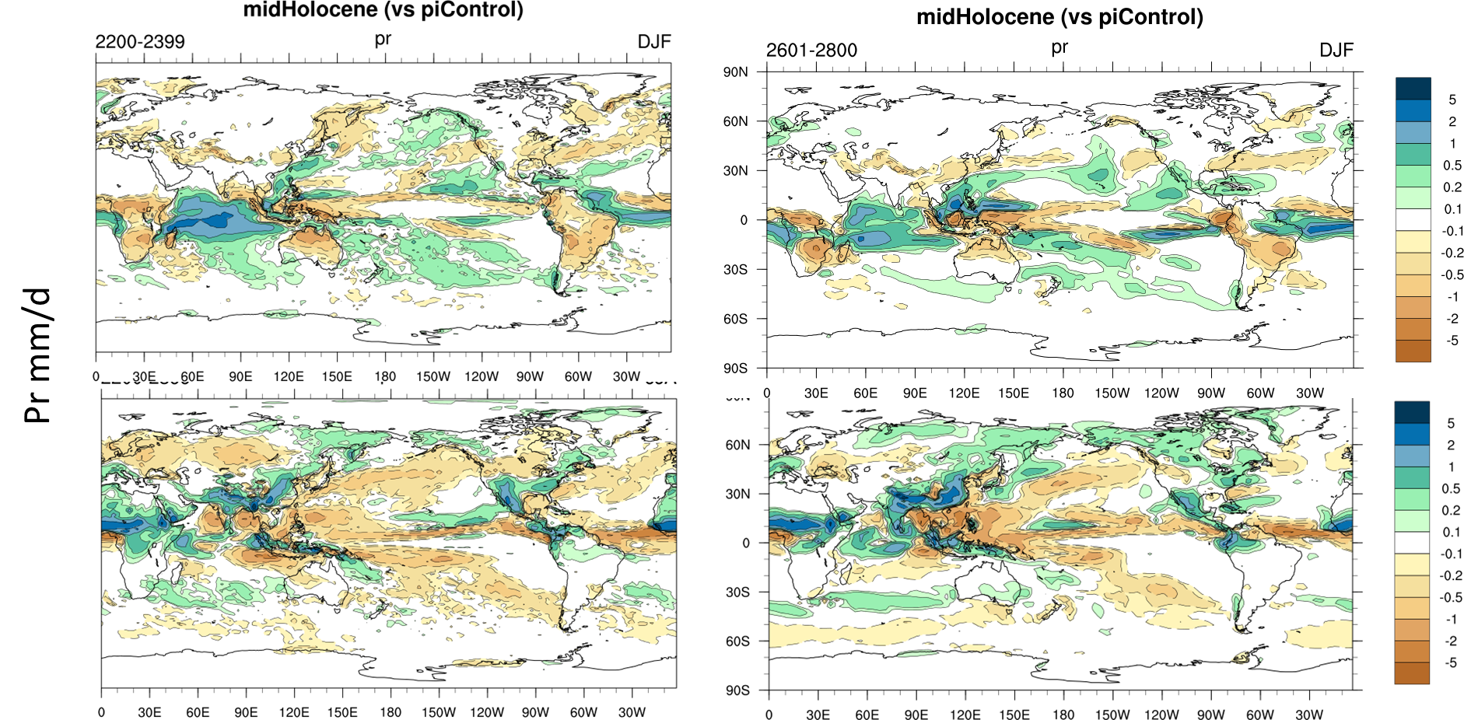
Mid Holocene Precipitation

Slide 7
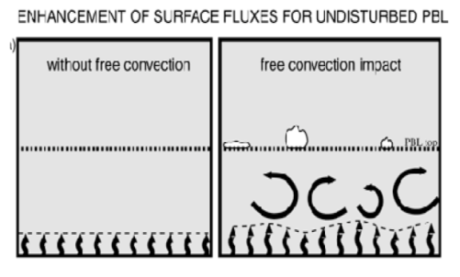
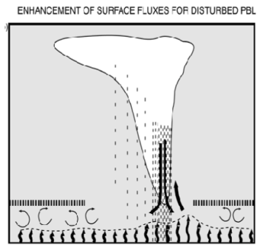
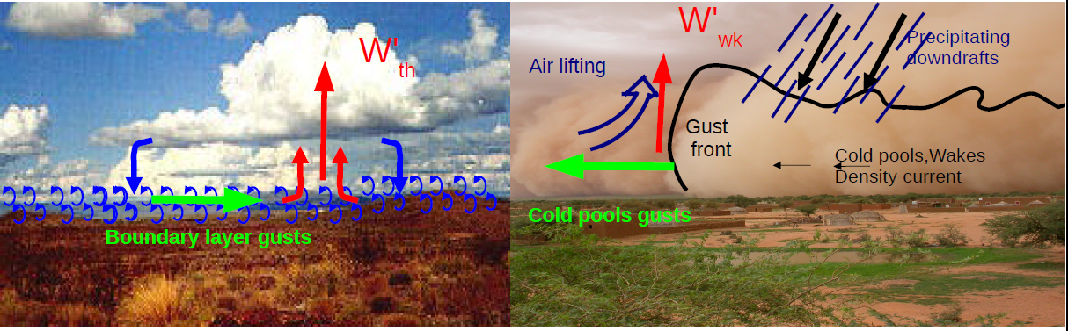
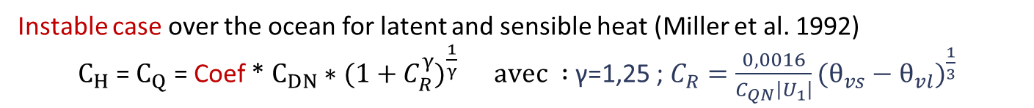
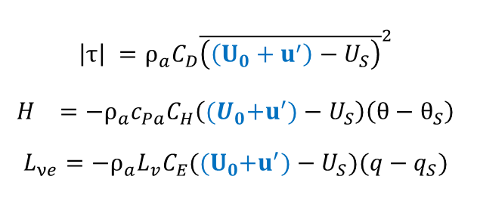
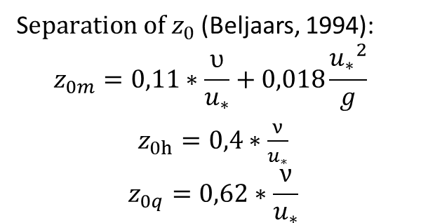

Role of air-sea fluxes?
Instable case over the ocean for latent and sensible heat (Miller et al. 1992)
$C_{H}$ = $C_{Q}$ = Coef * $C_{DN}∗(1+C_{R}^{γ})^{\frac{1}{γ}} avec :$γ=1,25 ; $C_{R}=\frac{0,0016}{C_{QN}\left|U_{1}\right|}(θ_{vs}−θ_{vl})^{\frac{1}{3}}$
From CM5
to CMIP6
S$eparation of z_{0}$(Beljaars, 1994):
$$z_{0m}=0,11∗\frac{υ}{u_{∗}}+0,018\frac{{u_{∗}}_{}^{2}}{g}$$
$z_{0h}=0,4∗\frac{ν}{u_{∗}}$
$$z_{0q}=0,62∗\frac{ν}{u_{∗}}$$
Add wind gusts(Redelsperger et al. (2000)) :
Consistent with thermals and cold pool parameterisations .
$$U_{}^{2}=U_{0}²+β^{2} {2ale}_{bl}+{α 2ale}_{wk}$$
Free convection
thermals
Deep convection
Cold pools
$$\left|τ\right| =ρ_{a}C_{D}{\overline{\left(\left(U_{0}+u^{′}\right)−U_{S}\right)}}^{2}$$
$$H =−ρ_{a}c_{Pa}C_{H}\left({(U}_{0}+u^{′})−U_{S}\right)\left(θ−θ_{S}\right)$$
$$L_{νe}=−ρ_{a}L_{v}C_{E}({(U}_{0}+u^{′})−U_{S})(q−q_{S})$$
Hourdin, Rio et al., 2008, 2010….

Slide 8
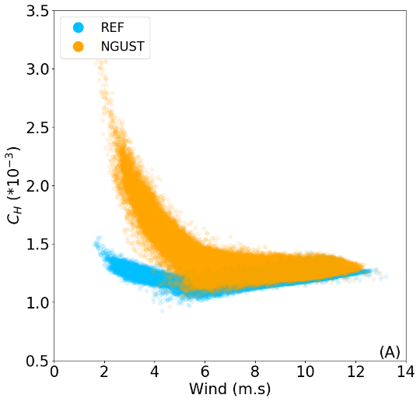
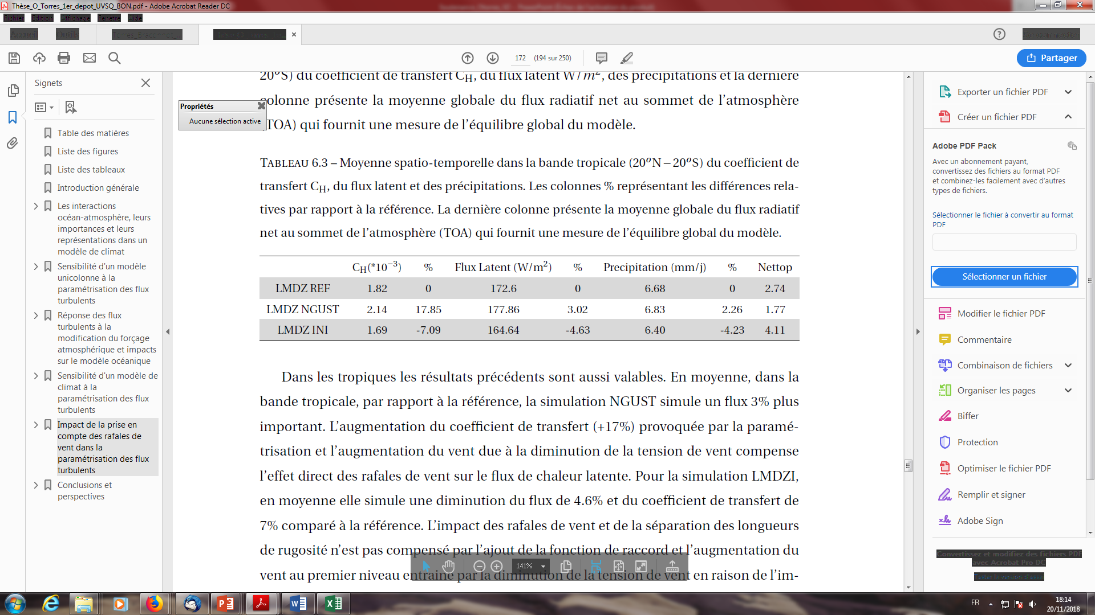
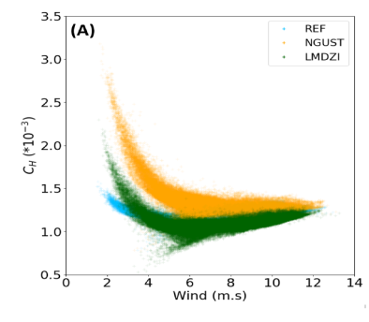
Ex sensitivity gust
  LMDZ REF : CMIP6 version (add gustiness)
  $$L_{νe}=−ρ_{a}L_{v}C_{E}({(U}_{0}+u^{′})−U_{S})(q−q_{S}) ; C_{X} =C_{XN}\text{∗}\text{f}\text{(}\text{S}\text{)} (\text{unstable}\text{)}$$
  LMDZ NGUST : CMIP5 version (old)
  $L_{νe}=−ρ_{a}L_{v}C_{E}\left(U_{0}−U_{S}\right)\left(q−q_{S}\right) ; C_{E}\text{ = }C_{EN}∗(1+C_{R}^{γ})^{\frac{1}{γ}}$(unstable)
Oceanic grid points
(30°N-30°S only)
Spatio-temporal mean
AGCM (20°N-20°S) :
C_{E} (*10⁻³)
Low wind speed function
Increase C_{E}
Regional effect (C_{E}, low wind)
LMDZI : large effect of 0.7 factor, smaller effet or Zo

Slide 9
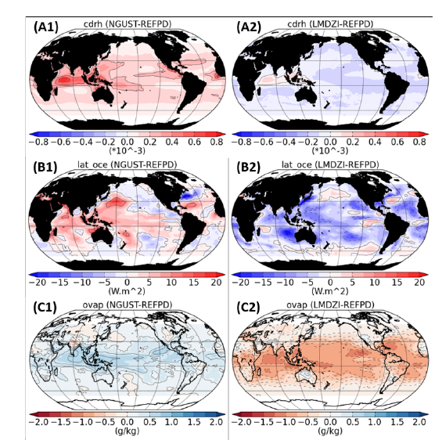
ATM
NGUSTgust :
Suppress u’
low wind speed function
LMDZI
Suppress u’
Effect of low wind speed function
Cqn= 0.7 Cdn
Separation z0
10-15WW/m2
Mean reduction due to 0.7
10-15W/m2
E/W gradient
Atl Nord
Torres, PhD, 2019

Slide 10
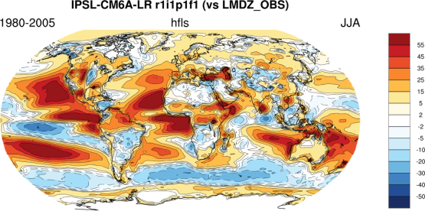
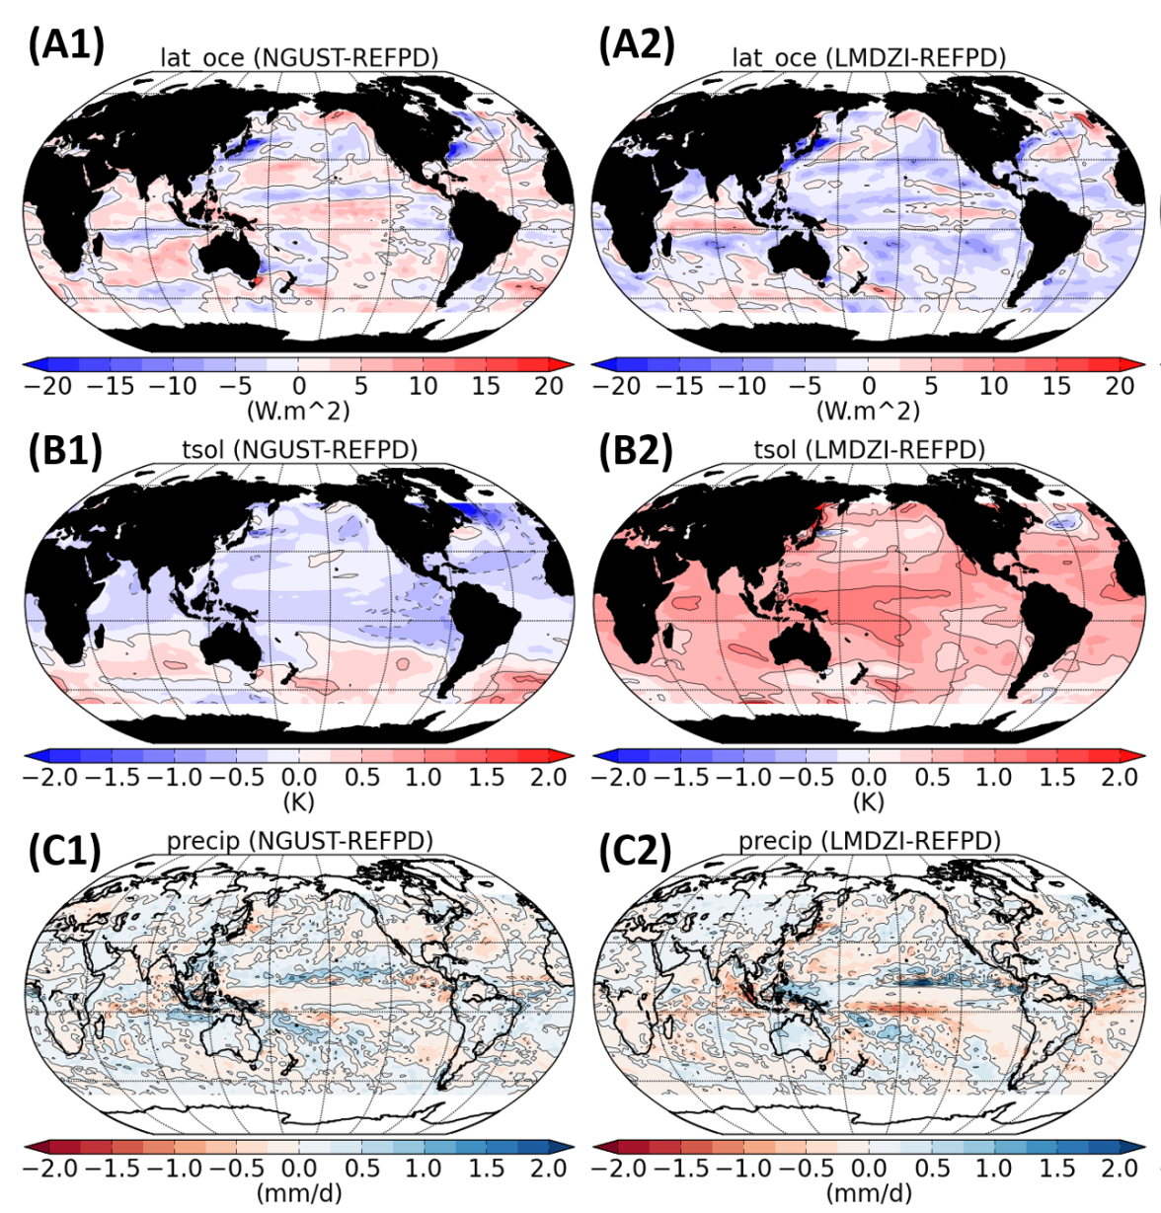
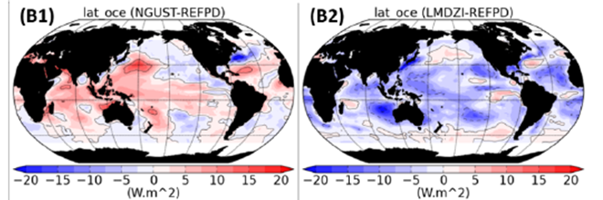
Coupled model
CM6 bias
At most 5-10 W/m2
Smaller than mean CM6 bias and than ATM
ATM

Slide 11
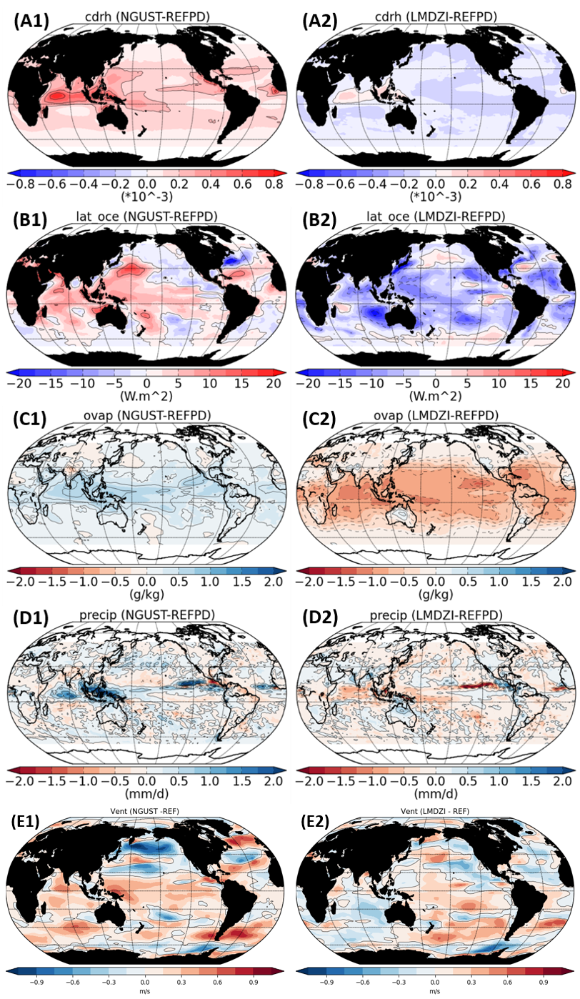
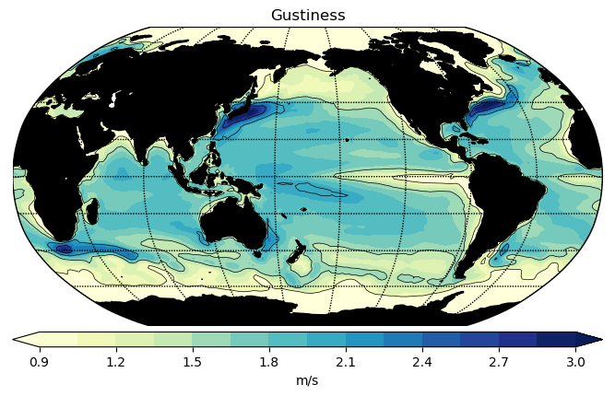

A sum of different feedbacks : AMIP
Flux de chaleur latente : $L_{νe}=−ρ_{a}L_{v}C_{E}({(U}_{0}+u^{′})−U_{S})(q0−q_{S})$
U_{S} = 0
q_{S} identique
NGUST - REFPD
C_{E}
q₀
Suppressed gustiness
W$ind effect(u^{′})$
Wind stress effect
-
+
u’
U₀
LH (W/m²)
(positive towards the atmosphere)

Slide 12
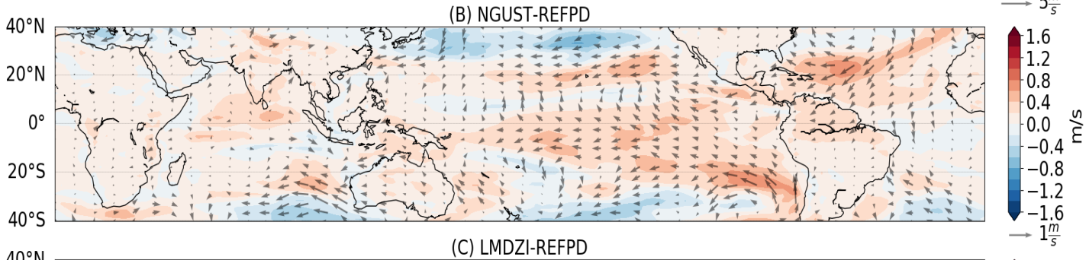
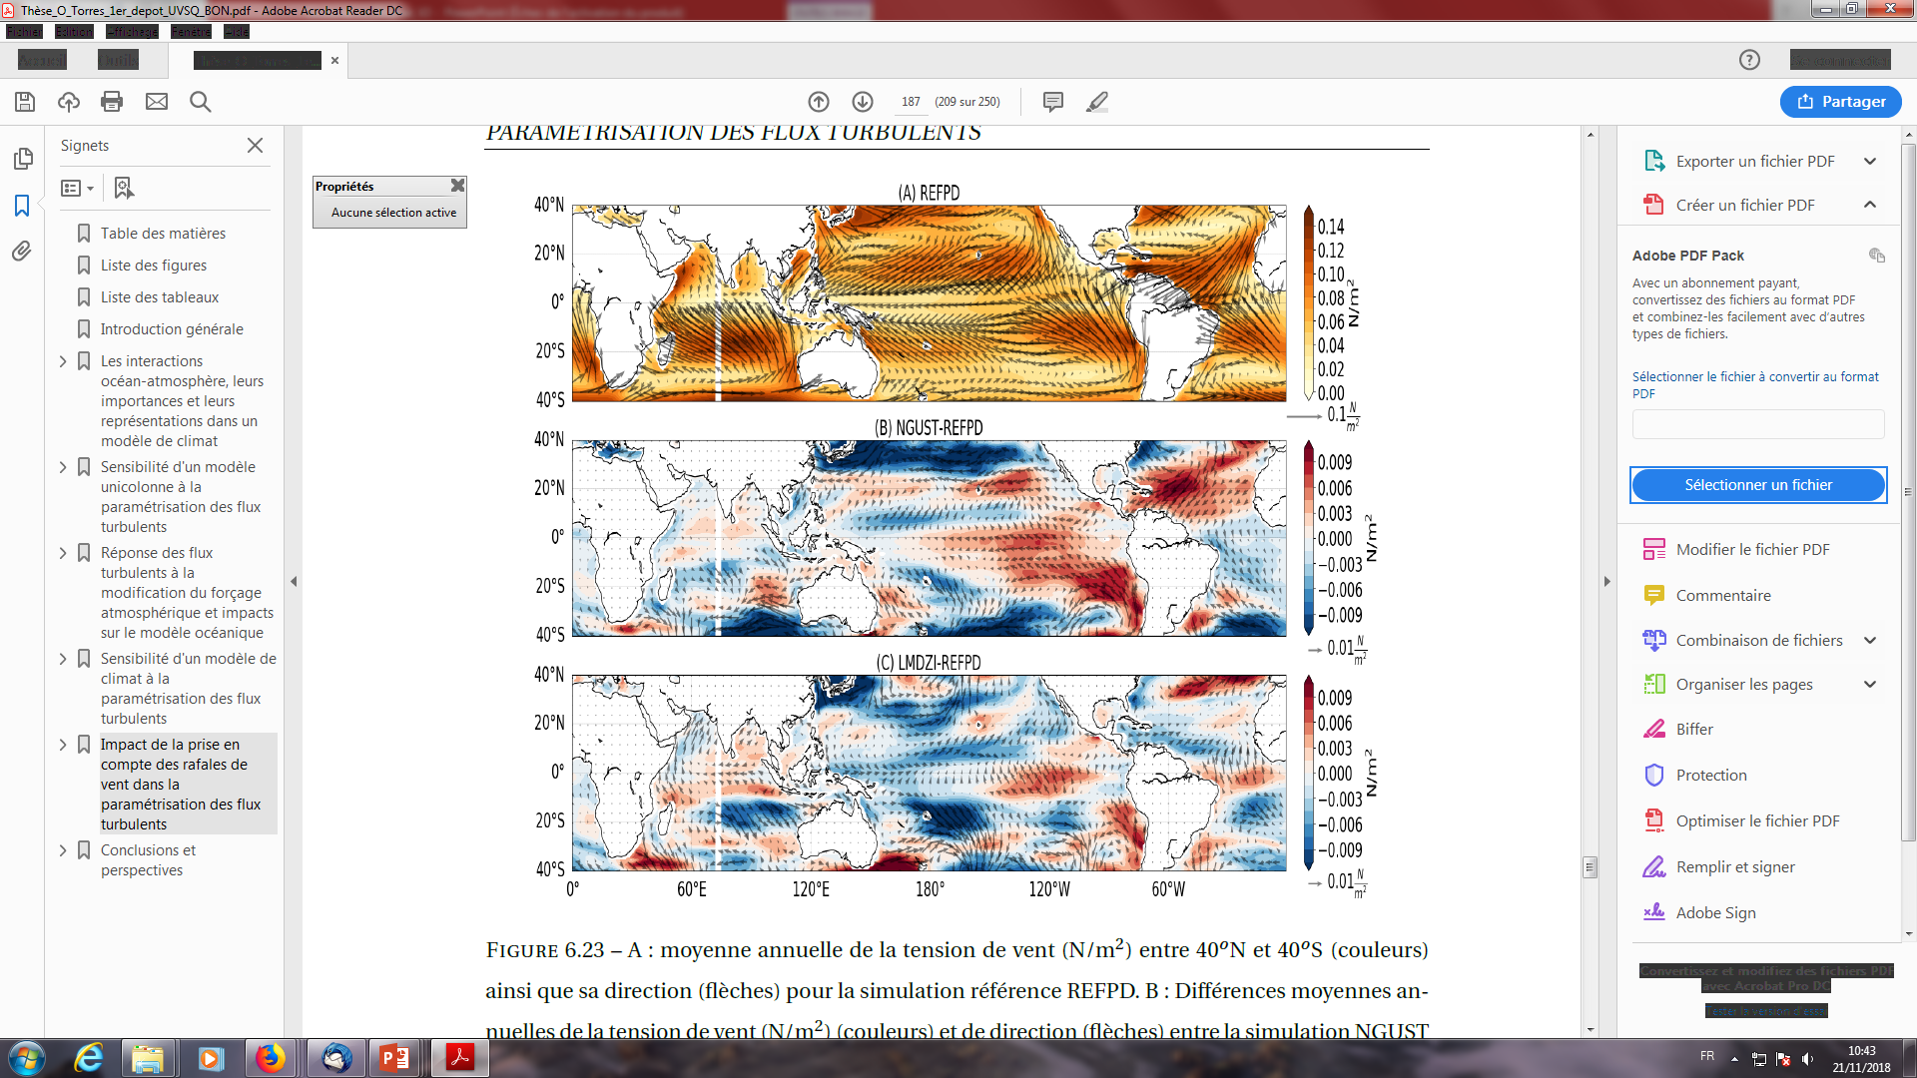
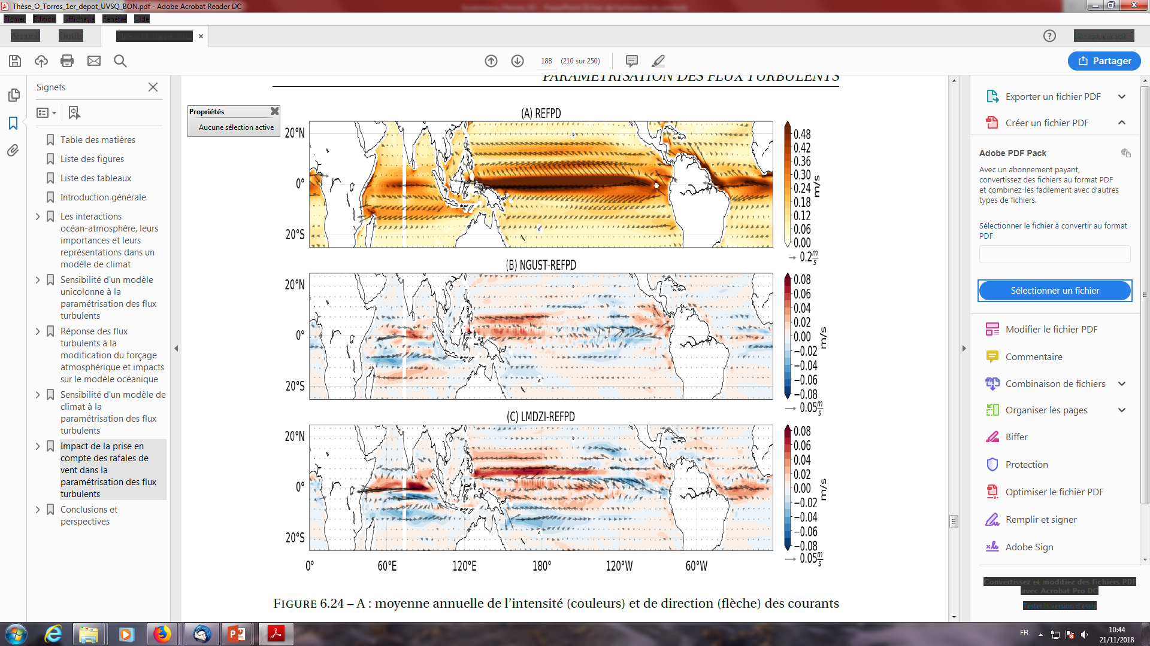
Wind and current feedback
Wind (m/s)
Wind stress (N/m²)
NGUST - REFPD
Surface current (m/s)

Slide 13
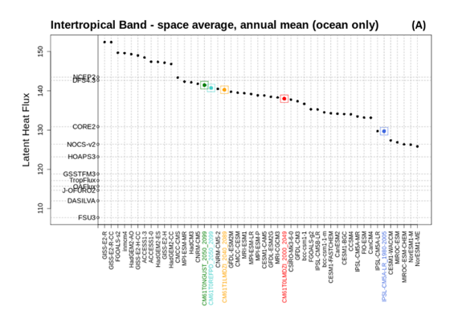
Conclusion
The new parameterization increases the consistency between wind gust/thermals/conversion
It impacts E/W and N/S gradients of large scale moist static energy and affect the large scale circulation
In the coupled system, feedbacks related to energetic adustment can mask the effect of the new processes.
Challenges :
Still difficult tohave both fluxes and state variables in agreement with observations
The surface flux parameterization changes have an impact on the atmospheric moisture content → Role on climate sensitivity?

Slide 16
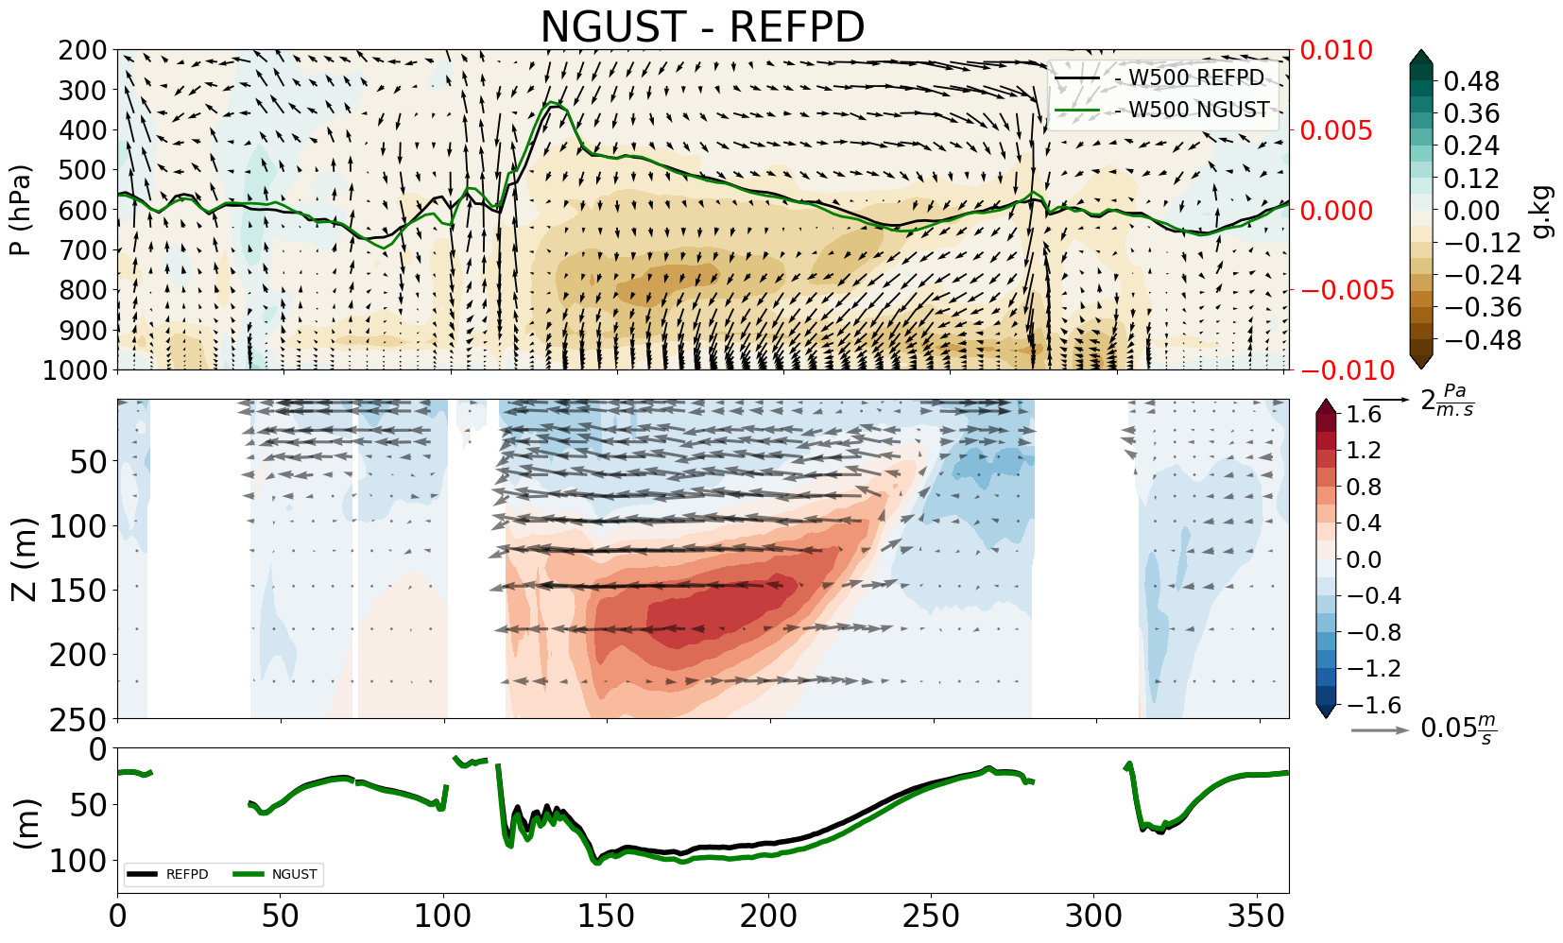

Gust in OAGCM
Spatio-temporal mean (5°N-5°S)
NGUST - REFPD
LH (W/m²)
SST (K)
K
Link C_{E}/SST/Humidity
Drying/Increase walker circulation
Effect of wind stress → increase oceanic circulation → increase atmospheric circulation

Slide 17
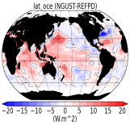
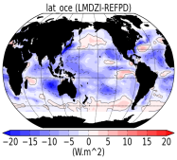
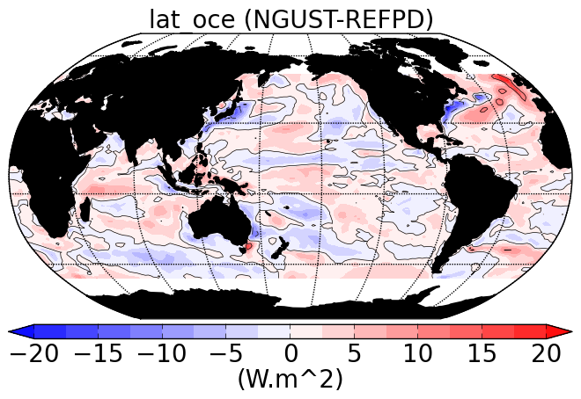
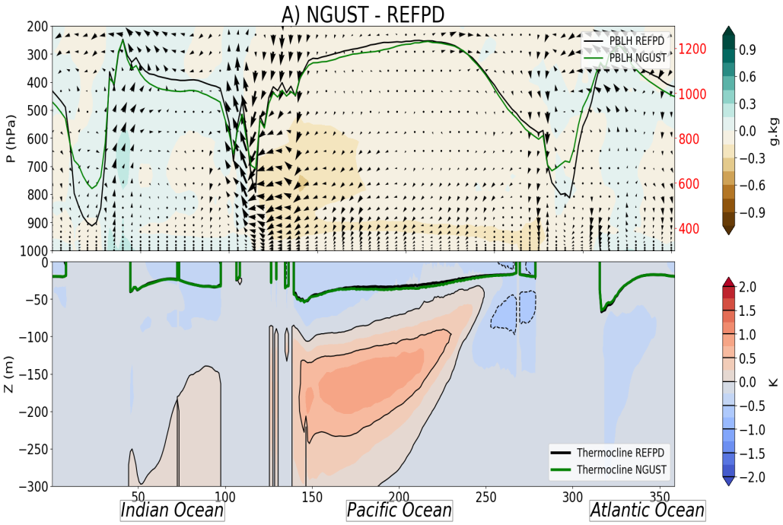
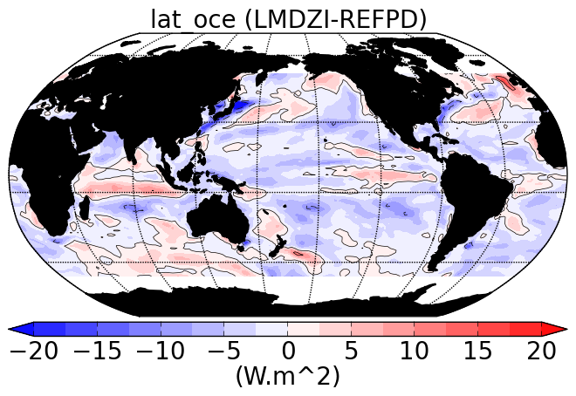
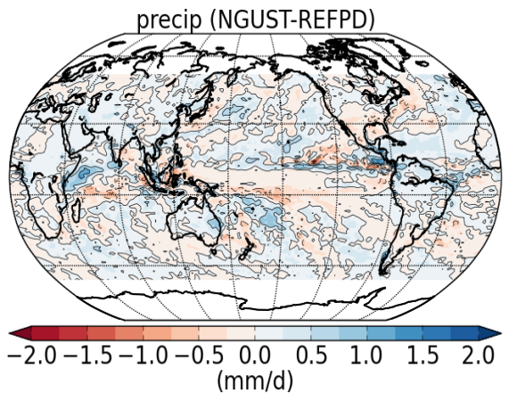
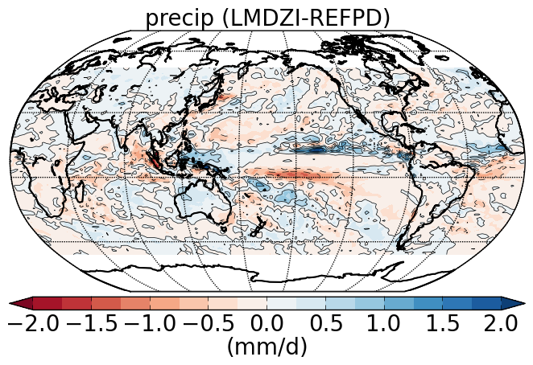
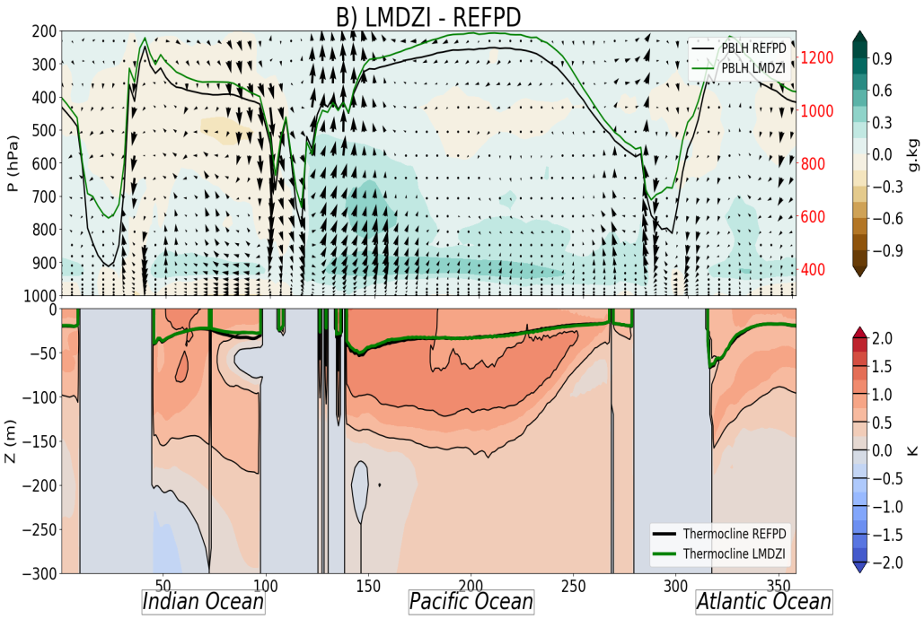
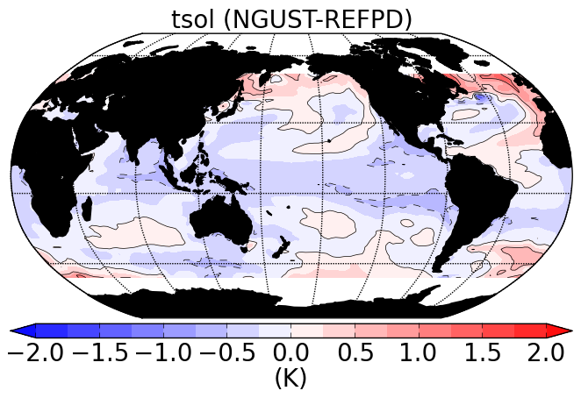
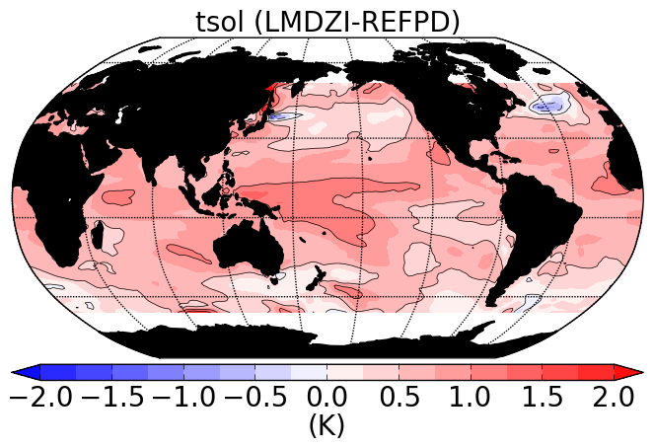
Couplé : en moyenne annuelle

Slide 18
Schematic loops for latent heat at surface
Latent heat flux : $L_{νe}=−ρ_{a}L_{v}C_{E}((U_{0}+u^{′})−U_{S})(q−q_{S})$
Delta
q
Indirect
effect
Wind at 1st level
-
Coeff
C_{E}
Latent heat fluxes
L_{ve}
gustiness
+
Wind for turbulent fluxes computation
Direct
effect

Slide 19
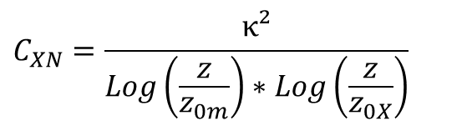
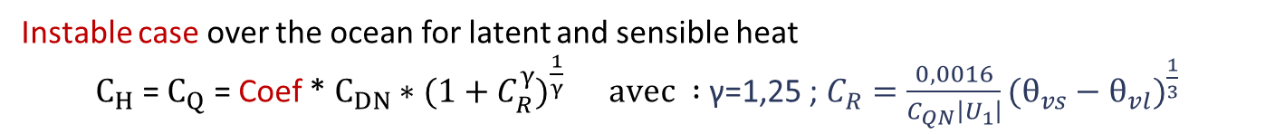
Previous LMDz formulation (CMIP5)
From Louis (1979) (ECMWF); Smith (1988, 1989) for roughness length; et Miller et al. (1992) for low wind speed
$$C_{XN}=\frac{κ²}{Log\left(\frac{z}{z_{0m}}\right)∗Log\left(\frac{z}{z_{0X}}\right)}$$
X = momentum, heat or specific humidity
$C_{X} =C_{XN}$*f(S) ; f(S), stability function estimated using the Richardso nnumber
    $z_{0X}=β\frac{υ}{u_{∗}}+α\frac{{u_{∗}}_{}^{2}}{g}$ ; viscosity effect v and wind/swell(Charnock, 1955)
Instable case over the ocean for latent and sensible heat
$C_{H}$ = $C_{Q}$ = Coef * $C_{DN}∗(1+C_{R}^{γ})^{\frac{1}{γ}} avec :$γ=1,25 ; $C_{R}=\frac{0,0016}{C_{QN}\left|U_{1}\right|}(θ_{vs}−θ_{vl})^{\frac{1}{3}}$

Slide 20
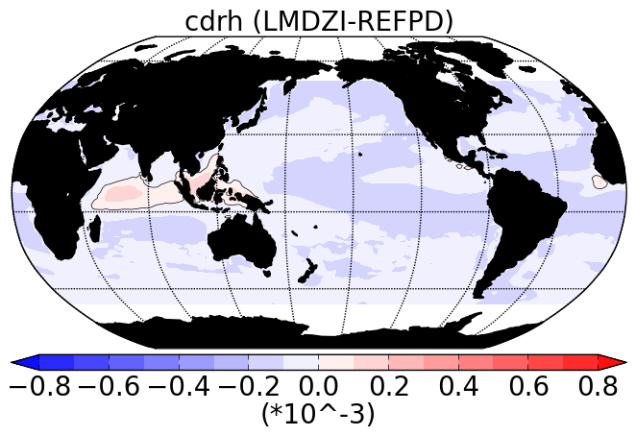
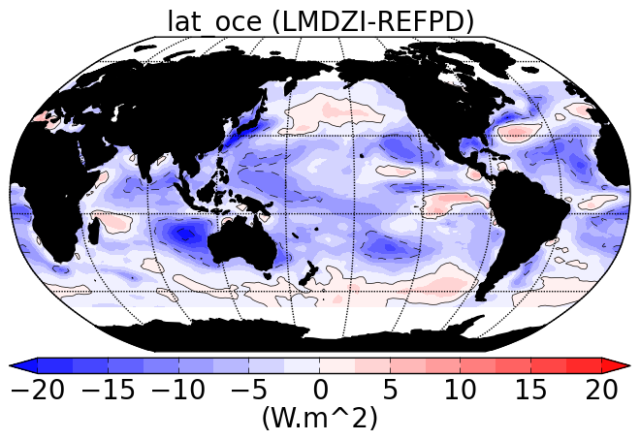
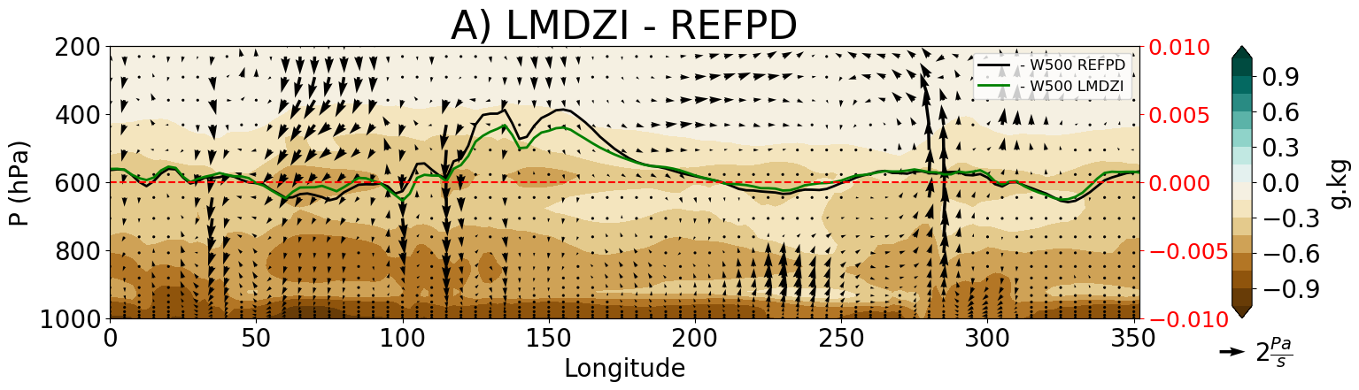
AMIP simulations : old/new parameterization
Atmosphere along the equator 5°NS-5°N
Indien
Pacifique Ouest
Pacifique Est
Atlantique

Slide 21
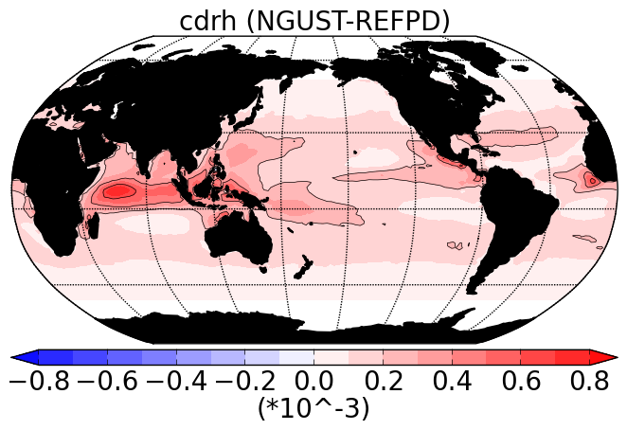
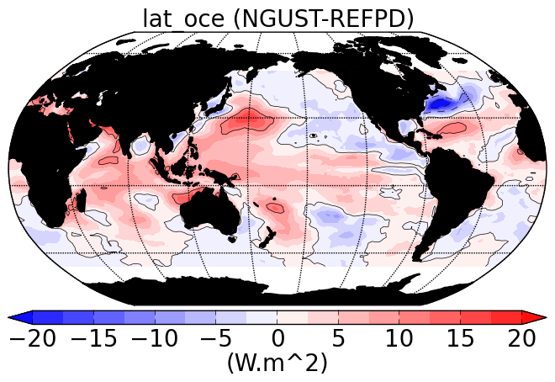

AMIP simulations : supressing wind gust
Atmosphere along the equator 5°NS-5°N : annual mean
Indien
Pacifique Ouest
Pacifique Est
Atlantique

Slide 22

MH : comparison IPSL simulations
Larger magnitude of seasonal cycle :

Slide 23



Hum not a revolution/ previsous results …
W Africa

